Slide 1
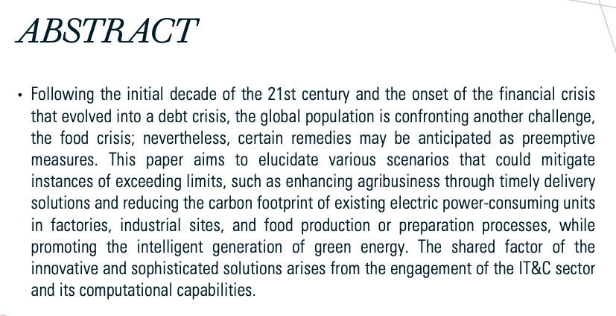
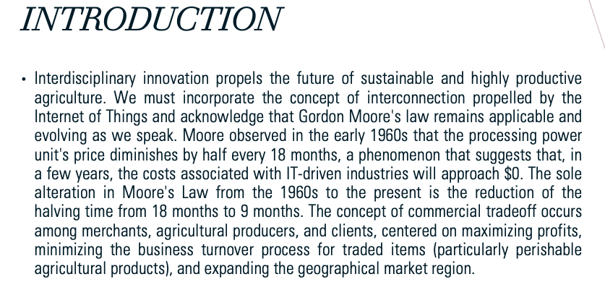
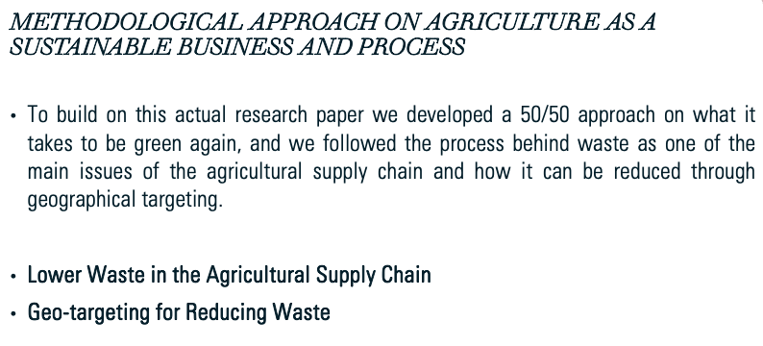
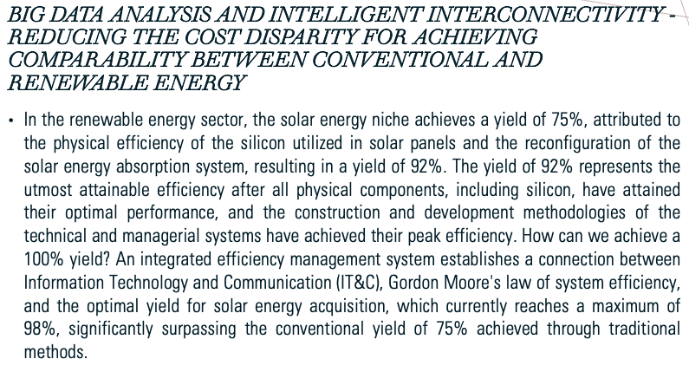
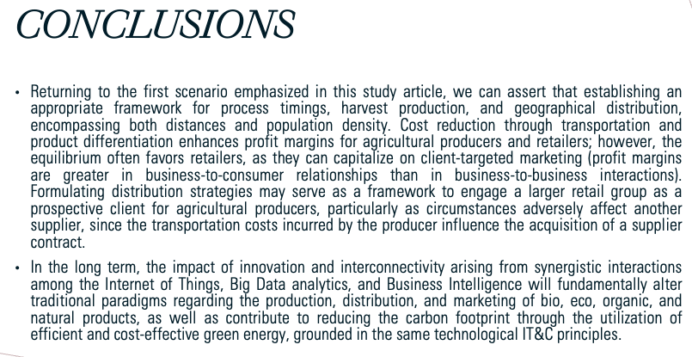
Make Agriculture and Energy Green Again
Bran Florina, Bodislav Dumitru Alexandru, Chiotan Radu Florin, Pârgaru Ion
Bucharest University of Economic Studies, Politehnica University of Bucharest
florinabran@yahoo.com

