Slide 1
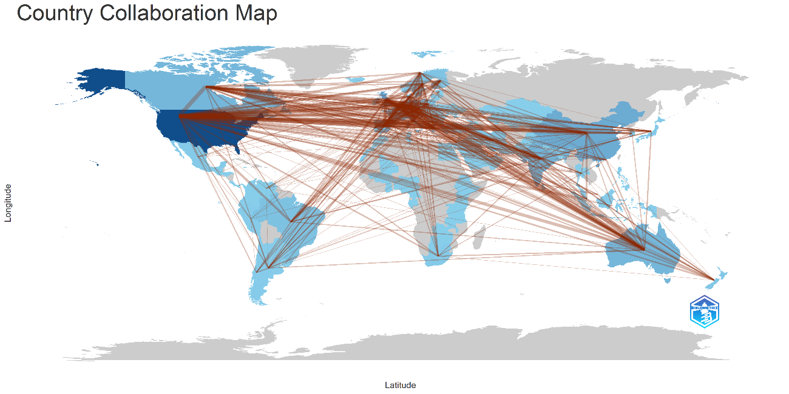
Abstract
Plant-based diets are increasingly recognized for their significant impact on human health and environmental sustainability, representing a fundamental pillar of sustainable food systems. This study examines both the benefits and the challenges associated with the consumption of plant-based products through a bibliometric analysis complemented by a review of the scientific literature performed in a qualitative manner. Bibliometrix software was employed in the bibliometric analysis for the purpose of processing 3.245 scientific articles extracted from, covering the period from 1957 to 2025.
The findings highlight a substantial increase over the last twenty years in scholars’ interest regarding the effects of plant-based diets upon adult well-being as well as the environment. The analysis of keyword co-occurrences as well as international collaboration reveals a predominant concentration of research in in both the U.S. and Europe, with a high degree contribution of Asia-Pacific region also. The study investigates the advantages of vegan diets from multiple perspectives, including nutritional, economic, environmental, and cultural, and integrates this approach with an exploratory quantitative analysis. Furthermore, the paper discusses several barriers to the adoption of such dietary patterns, including concerns about potential nutrient inadequacies, the perception of higher costs, limited accessibility, and social constraints. The study concludes that, despite the existence of certain barriers, vegan diets can provide considerable benefits for both individuals and society, as extensively reported in scientific literature and recommends targeted educational initiatives, economic interventions, and well-designed public policies to overcome these challenges and support the transition toward sustainable dietary practices. The results offer a comprehensive understanding of current research directions and lay the groundwork for future efforts aimed at promoting sustainability among the general population.
Figure no. 2: Map of international collaborations in plant-based diet research
Source: Bibliometrix author data processing
Perspectives in the Scientific Literature on the Barriers and Benefits of the Transition to a Plant-Based Diet: A Bibliometric Analysis
Ana-Maria Badea, Lelia Voinea, Dorin Vicențiu Popescu, Teodor Mihai Negrea, Răzvan Dina, and Maria-Bogdana Necșescu
Bucharest University of Economic Studies, Bucharest, Romania
anamaria.badea@ase.ro; lelia.voinea@com.ase.ro; dorin.popescu@com.ase.ro; teodor.negrea@com.ase.ro rdina@ase.ro; maria.necsescu@stud.ase.ro
Research methodology
This research attempted for highlighting the primary research apprehensions when we scrutinized the literature of herbal consumption via bibliometric analysis quantitatively. The principal ad-vantages and impediments to ingesting herbal supplements were additionally accentuated via a qualitative examination of the literature.
In order to pinpoint the most applicable works, investigators employed a compilation of search terms: (‘plant-based diet’ OR ‘vegetarian diet’ OR ‘vegan diet’ OR ‘plant-forward diet’ OR ‘flexi-tarian diet’) AND (‘food consumption’ OR ‘dietary patterns’ OR ‘eating habits OR ‘nutrition’ OR ‘nutritional quality’ OR ‘sensory quality’ OR ‘disease prevention’ OR ‘environmental impact’ OR sustainability OR barriers OR benefits). The span that was analysed occurred between 1957 and 2025, to highlight the evolution of citizen interest over decades.
Results and discussion
The analysis led to the identification of 3.245 scientific articles relevant to the consumption of plant-based foods. The considerable volume of papers reflects the extent and growing interest of researchers in this topic, particularly in the last two decades.

