Slide 1
Generational Differences in the Perceptions and Usage of Self-Scanning and Paying Counters in Supermarkets
Irina Maiorescu, Mihaela Bucur and Gabriel Cristian Sabou
The Bucharest University of Economic Studies, Bucharest, Romania.
E-mail: irina.maiorescu@com.ase.ro; mihaela.bucur@com.ase.ro; gabriel.sabou@csie.ase.ro

Slide 2
Research Methodology
Study Parameters
126 respondents from urban areas
Mix of genders and age groups
All with access to supermarkets equipped with self-scanning technology
Respondents shop physically at least once per week
Non-normal distribution of ordinal data analyzed using Mood's test
The frequent shopping habits of participants created numerous opportunities for interaction with self-scanning equipment, ensuring answers founded on real user experience.
Statistical analysis included Wilcoxon Signed test for median (skewness coefficient: -0.24) and Mood's Median Test with significance value set at 0.05.

Slide 3
Motivation to Visit Supermarkets with Self-Scanning
3
2
1
Under 25 Years
26-35 Years
36-45 Years
Highest motivation level to visit supermarkets with self-scanning technology
Average motivation level to visit supermarkets with self-scanning
Lowest motivation level, placing minimal importance on self-scanning availability
2
Over 46 Years
Average motivation level, but with higher variability (interquartile range: 1.5)
The Mood test shows that motivation to visit supermarkets based on self-scanning availability tends to decrease with age. The p-value below 0.05 confirms significant differences between generations, validating research hypothesis H1.

Slide 4
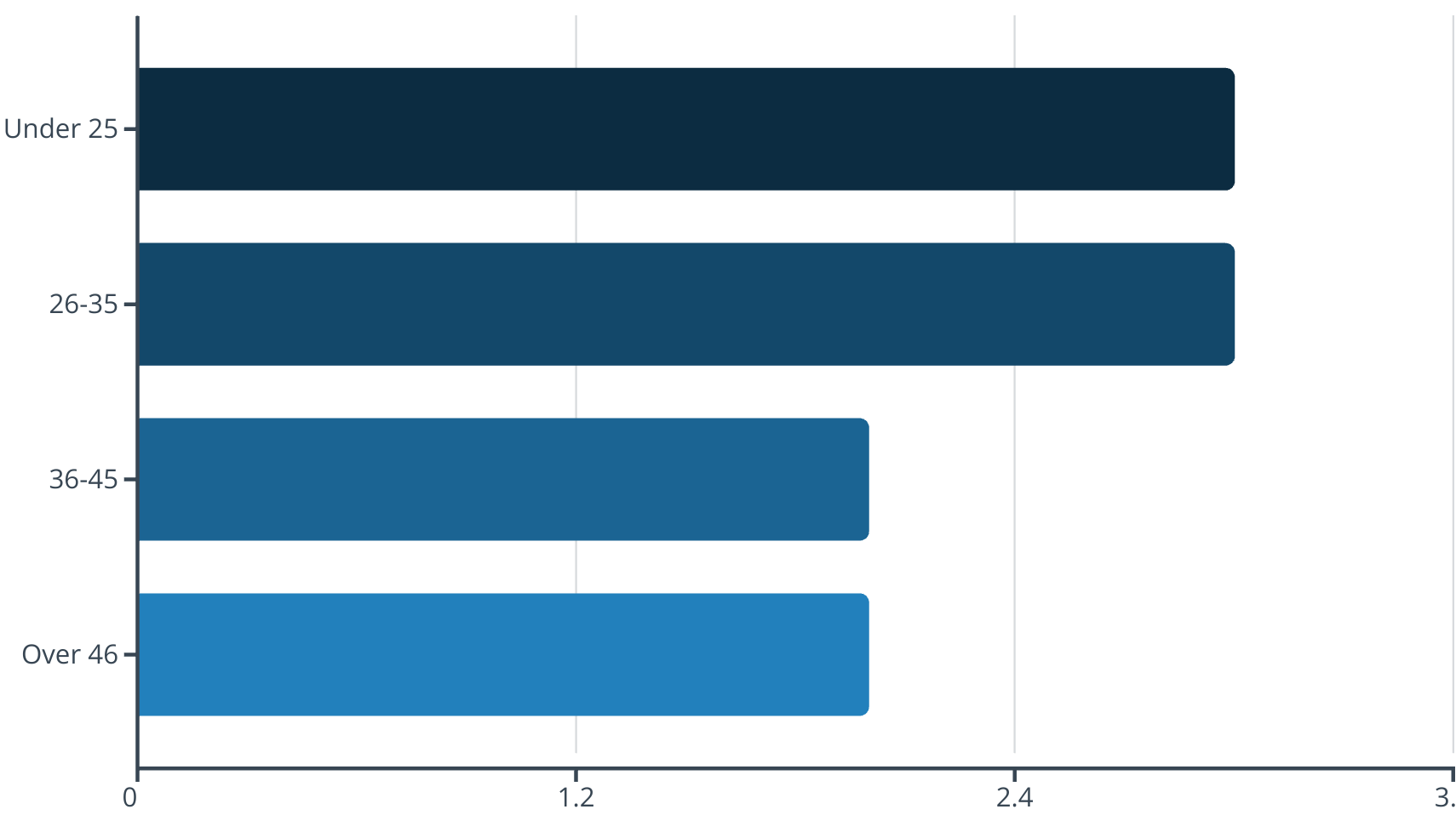
Perceived Benefits Across Generations
Key Findings on Perceived Benefits
Significant generational differences (p-value: 0.000)
Respondents under 35 rate benefits as "high" (median: 3)
Older respondents perceive "moderate" benefits (median: 2)
Age group 36-45 shows higher variability in responses (interquartile range: 2.00)
Research hypothesis H2 confirmed: age impacts perception of benefits

Slide 5
Ease of Use Across Age Groups
Under 25 Years
26-35 Years
Median: 3.0
Median: 3.0
Interquartile Range: 0.00
Interquartile Range: 0.00
Confidence Interval: (3, 3)
Confidence Interval: (3, 3)
Consistently find self-scanning very easy to use
Also find technology very straightforward
Over 46 Years
36-45 Years
Median: 2.5
Median: 3.0
Interquartile Range: 1.75
Interquartile Range: 1.00
Confidence Interval: (1, 3)
Confidence Interval: (2, 3)
Find technology slightly more complicated
Generally find it easy but with more variation
The p-value of 0.003 confirms research hypothesis H3: there are significant differences among generations regarding perceived ease of use. The Spearman correlation coefficient (-0.399, p-value<0.05) indicates a moderate negative connection between ease of use and time spent at self-scan counters.

Slide 6
Time Efficiency Comparison
Time Spent at Self-Scan vs. Traditional Counters
Age Group
Median
Interquartile Range
Confidence Interval
Under 25 years
1
0.0
(1, 1)
26-35 years
1
0.0
(1, 1)
36-45 years
1
1.0
(1, 2)
Over 46 years
2
1.5
(1, 3)
Median score of 1 indicates less time spent compared to traditional checkout, while 2 indicates comparable time.
Key Findings
Younger shoppers (under 35) consistently experience time savings
Middle-aged shoppers (36-45) generally save time but with more variation
Older shoppers (over 46) report comparable time to traditional checkout
Significant generational differences confirmed (p-value: 0.000)
Research hypothesis H4 validated

Slide 7
Key Research Findings
1
Motivation Decreases with Age
Younger consumers (under 25) are significantly more motivated to visit supermarkets offering self-scanning facilities, with motivation declining as age increases.
2
Benefit Perception Varies by Generation
Respondents under 35 perceive self-service technologies as highly beneficial (median: 3), while older participants view them as only moderately advantageous (median: 2).
3
Usability Challenges for Older Users
While most age groups find these technologies user-friendly, those over 45 report slightly more difficulty (median: 2.5), indicating potential usability barriers for older consumers.
4
Time Efficiency Age Gap
Younger users experience time savings with self-scanning options compared to traditional checkouts, while older respondents (over 46) often find the time spent comparable to conventional methods.

Slide 8
Conclusions and Implications
Research Contributions
Provides age-specific insights into consumer behavior toward self-service technologies
Reinforces Technology Acceptance Model within a generational context
Highlights age-specific patterns in motivation, perceived benefits, ease of use, and time efficiency
Offers practical benefits for retail management decision-making
Limitations
Non-probability, self-selection sampling limits extrapolation
Relatively small sample size in the over 46 age group
Urban-only demographics potentially exclude rural perspectives
Practical Implications
Retailers should consider age-specific strategies:
Leverage self-scanning technology to attract younger shoppers
Provide additional support and education for older consumers
Enhance interface usability for older demographics
Consider maintaining traditional checkout options
Future Research Directions
Explore how exposure and training influence technology acceptance
Expand sample to include rural populations
Investigate additional demographic factors beyond age

