Slide 1
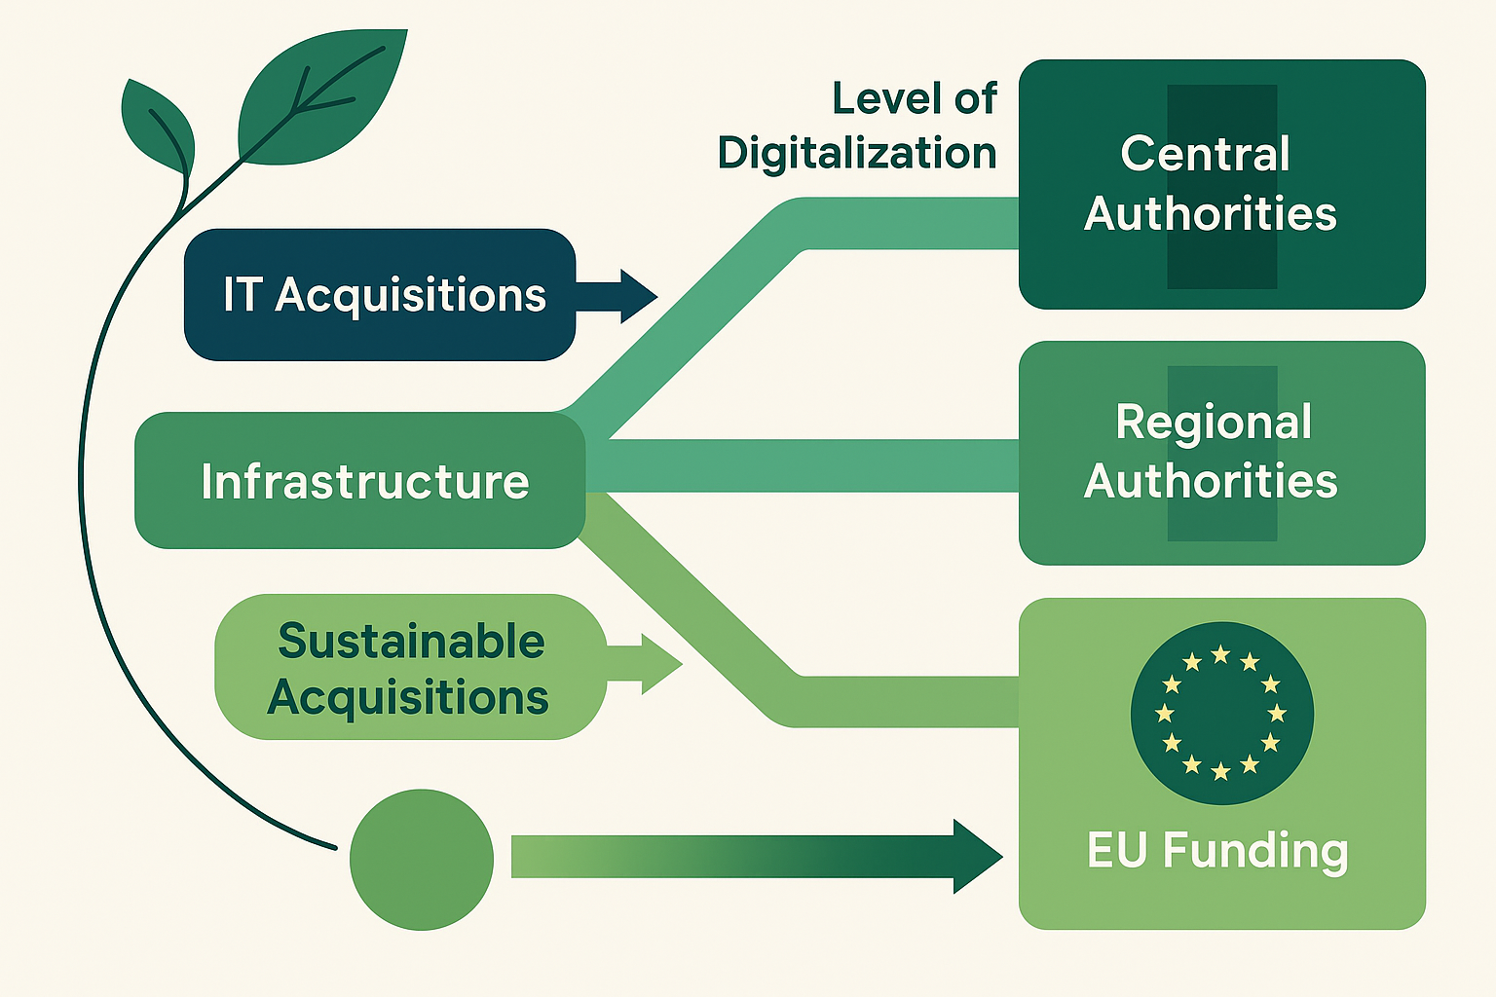
Digitalization of public administration and its impact on sustainability in institutional consumption: An exploratory analysis of open government data
Oana Camelia IACOB (PÂRGARU)¹, Emil GRĂTIANU², Sorin BURLACU³ and Petrică Sorin ANGHELUȚĂ⁴
¹⁾ University POLITEHNICA of Bucharest, Romania
²⁾ ”Valahia” University of Târgoviște, Targoviste, Romania
^{3), 4)} Bucharest University of Economic Studies, Bucharest, Romania
E-mail¹: oana_camelia.iacob@upb.ro; E-mail²: ion.pargaru@gmail.com
E-mail³: sburlacu@amp.ase.ro; E-mail⁴: sorin.angheluta@amp.ase.ro
Abstract
The aim of this article is to explore the impact of public administration digitalization on the efficiency of institutional consumption, in the context of accelerating digital transformation and the use of European funds. The study analyzes the relationship between the degree of digitalization and the dynamics of public procurement, with a focus on the differentiation between procurements financed from European funds and those from other sources.
The research design is exploratory, based on a quantitative approach using open government data collected from the official platform data.gov.ro, for the period 2020–2024. The selected datasets include information on direct procurements made by public institutions in Romania. The statistical analysis was performed in the Anaconda environment, using Python tools such as Pandas, Matplotlib and Seaborn, and the methodology included preliminary data processing, construction of composite indicators and application of Pearson correlation coefficients.
The results indicate a moderate correlation (r = 0.46) between the share of procurement financed from European funds and the general dynamics of institutional procurement. This relationship suggests that the digitalization of public procurement processes, associated with European funding (including through programs such as PNRR), can have a positive impact on operational efficiency and reducing dependence on traditional resource-consuming procedures.
The originality of the research lies in the integration of open data analysis with the assessment of institutional sustainability, addressing an area still insufficiently covered in the specialized literature. The article proposes a replicable quantitative analysis model, based on the use of open-source resources, for assessing the impact of digitalization on sustainability in the public sector.
The practical implications of the study aim to support decision-makers in formulating public policies that accelerate sustainable digitalization and optimize institutional consumption in the public sector
Figure 1. Correlation between types of public procurement, the level of digitalization of authorities and European funding
Acquisition Type | Funding through European funds | Internal Funding | Growth after PNRR | Long-term Impact
IT Acquisitions | Yes | No | High | Positive
Service Acquisitions | Yes | Partially | Medium | Medium
Infrastructure Acquisitions | Yes | Yes | High | Major
Sustainable Acquisitions |  | Yes | Small | Significant
Introduction:
In a context where digitalization is a priority for the modernization of public administration, it is essential to analyze how this transformation influences resource consumption and institutional sustainability. The introduction below provides a clear perspective on the objectives and motivation of the research.
Main ideas:
The digitalization of public administration offers major opportunities to modernize state institutions and improve services to citizens.
The rapid development of information technologies has contributed to:
better resource management,
increased transparency,
increased administrative efficiency.
Digitalization can lead to a reduction in the consumption of physical resources (paper, energy, fuel), thus contributing to the sustainability of public institutions.
The effects of digitalization on resource consumption and environmental impact are not sufficiently studied in the specialized literature.
Although digitalization is often associated with cost reduction and operational efficiency, the direct link with the reduction of resource consumption is poorly documented.
Research goal: to analyze the impact of digitalization on the sustainable consumption of resources in public administration.
Period analyzed: 2020–2024, through open government data.
The aim is to identify correlations between the level of digitalization and the reduction of physical resource consumption.
Table 1. Correlation between acquisition types and funding sources
Table 1 illustrates the correlation between the different types of procurement analyzed and the funding sources available for them and presents an estimate of the anticipated growth after the implementation of the National Recovery and Resilience Plan (NRRP), as well as the long-term impact of each type of procurement.
The perspective in Table 1 on how the different types of procurement intersect with funding sources and their potential impact indicates a dependence on European funds for all categories of procurement analyzed, which underlines the importance of accessing these resources for development. Regarding domestic financing, this seems to be particularly relevant for infrastructure and sustainable procurement, suggesting a co-financing or national budgetary allocation for these strategic areas.
The anticipated growth after the PNRR is assessed as high for IT and infrastructure procurement, indicating a significant potential to boost these sectors through the plan. Service procurement is estimated to have a medium growth, while sustainable procurement is seen with a lower growth, possibly due to the specificity and complexity of their large-scale implementation in a short time horizon.
Ultimately, the long-term impact is considered positive for IT procurement, medium for services, major for infrastructure (which is to be expected given the nature of the investments) and significant for sustainable procurement. This last category, although with a more modest initial growth, promises substantial long-term benefits, aligning with sustainability and resilience objectives.
Table 2 illustrates the qualitative differences observed between central, regional and local authorities in Romania in terms of access to European funds, the volume and value of implemented projects, as well as the level of integration of digitalization in their activities.
Authority Type | European Funds Accessibility | Volume of Implemented Projects | Scale of Realized Investments | Level of Digitalization Integration
Central Authorities | Navigates the complex landscape of European funding with expertise, demonstrating a high capacity to access various opportunities. | Notable for an extensive portfolio of funded initiatives, covering a wide range of domains. | Mobilizes significant financial resources, reflecting the scope of national projects. | The integration of digital solutions is profound and strategic, aiming for structural modernization.
Regional Authorities | Demonstrates an active engagement, but faces intermediate complexity in the application and management of funds. | Presents a considerable number of projects, adapted to the regional specifics and zonal development priorities. | Carries out investments with a substantial value, contributing to economic and social growth at the regional level. | The adoption of digital technologies is under development, with the potential for expansion and deepening.
Local Authorities | Encounters significant difficulties in navigating European procedures, having an often restricted access to opportunities. | Characterized by a reduced volume of funded projects, often concentrated on immediate needs and limited capacities. | The investments made are of a more modest scale, reflecting budgetary constraints and the complexity of accessing large funding. | The level of digitalization is in an early stage, with significant needs for investment and know-how.
Table 2. Qualitative differences between central and local authorities in the use of European funds
Conclusions
This exploratory investigation deepens the interconnection between the digitalization of public administration and the efficiency of institutional consumption in Romania, placing the analysis in the dynamic context of digital transformation and the mobilization of European funds. By examining open government data from the period 2020-2024, the research reveals a moderate correlation (r = 0.46) between the proportion of procurements financed from European sources and the overall trajectory of procurements carried out by public institutions. This finding, although not indicating an absolute causal dependence, suggests a positive influence of the digitalization of procurement processes, often catalyzed by access to European funding (including through mechanisms such as the National Recovery and Resilience Plan), on optimizing operational efficiency and reducing the recurrence of traditional, inertially resource-consuming procedures.
The intrinsic originality of this research emanates from the rigorous combination of open data analysis with multidimensional assessment of institutional sustainability – a field that, despite its growing relevance, remains relatively under-explored in the current academic landscape. By proposing a replicable quantitative analytical model, based on the use of open-source resources, the study offers a concrete methodology for assessing the impact of digitalization on the sustainable dimension of public sector functioning. This innovative methodological approach opens new horizons for future research and facilitates a more nuanced understanding of the mechanisms through which digital technology can contribute to a more accountable and efficient public administration.
From the perspective of practical implications, the conclusions of this research argue for the need to formulate and implement coherent and ambitious public policies, designed to accelerate the process of sustainable digitalization across the entire spectrum of public administration. Furthermore, they highlight the importance of strategically aligning digitalization investments with European funding opportunities, to optimize institutional consumption and promote more transparent, efficient and sustainable public procurement practices. In essence, the study advocates for an integrated vision of digitalization, not as an end, but as an essential strategic tool for building a modern, resilient and future-oriented public administration.

