Slide 1
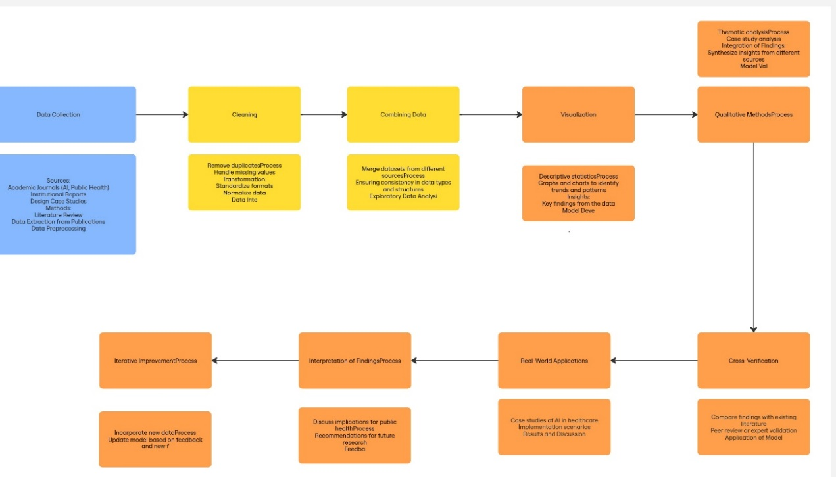
Title Approaches to Using Artificial Intelligence and Big Data to Improve the Efficiency of Public Health Institutions
Authors Arginteanu Andreea-Maria, Daniela Ioana Manea, Anca Costin Belean
Affiliation Auxologico CardioRec, Bucharest, Romania; The Bucharest University of Economic Studies, Bucharest, Romania ; Super Fresh SRL, Târgu Mureș, Romania
Email: arginteanu.andreea1@gmail.com; daniela.manea@csie.ase.ro; anca@cilfood.ro
Introduction
In recent years, we’ve witnessed a growing reliance on Artificial Intelligence (AI) and Big Data in public health. Faced with rising patient demands, financial constraints, and aging populations, health systems are increasingly turning to digital solutions. Our work explores how these technologies can support smarter decision-making, improve resource use, and ultimately enhance the efficiency of public health institutions. We draw on real-world cases and practical implementations to highlight what’s working and where challenges remain.
Methodology
To understand the actual impact of AI and Big Data, we followed a qualitative research approach. We reviewed academic studies, policy reports, and examined real use cases from multiple countries. This allowed us to map out how AI tools—like predictive models and natural language processing—are being integrated into public health systems. Figure 1 outlines the AI pipeline we used as a reference: starting with data collection and ending with deployment and feedback in clinical environments.
Main Findings
Our findings reveal several areas where AI and Big Data are already making a measurable difference:
Predictive Analytics: AI helps forecast both infectious and chronic diseases, enabling earlier and more targeted interventions.
Resource Efficiency: Machine learning tools help hospitals manage emergency room demand, staff allocation, and supply chain logistics more efficiently.
Text Analysis (NLP): NLP makes sense of unstructured clinical notes, improving disease tracking and easing documentation workloads.
Chatbots and Virtual Assistants: These tools handle basic admin tasks, triage, and patient support, especially useful during crises like COVID-19.
Policy and Planning: Big Data dashboards allow for real-time monitoring and strategic modeling to guide public health decisions.
Real-World Examples
We analyzed several countries that have applied these technologies successfully:
South Korea: Combined AI with real-time data (CCTV, card transactions) for fast COVID-19 contact tracing.
UK: The NHS used AI (DeepMind’s Streams) to detect acute kidney injuries earlier and improve outcomes.
Romania: Our home country has made key progress by digitizing health records, setting the stage for broader AI adoption in the future.
Ongoing Challenges
Despite the potential, we identified several obstacles:
Data Privacy: AI systems must respect privacy laws like the GDPR and ensure public trust.
Bias and Fairness: Algorithms need to be trained and tested carefully to avoid reinforcing health inequalities.
Infrastructure Gaps: Many systems lack the digital maturity needed to support advanced AI.
Regulation: Clearer legal frameworks are needed to ensure safe, accountable use of AI in public services.
Conclusions
Our research shows that AI and Big Data aren’t just future trends—they’re already shaping how healthcare is delivered. When applied thoughtfully, they can support earlier diagnosis, smarter resource use, and better patient outcomes. But for these tools to scale responsibly, we need investment in infrastructure, staff training, and strong governance. If done right, this digital shift could help make public health systems more proactive, fair, and resilient.

