Slide 1
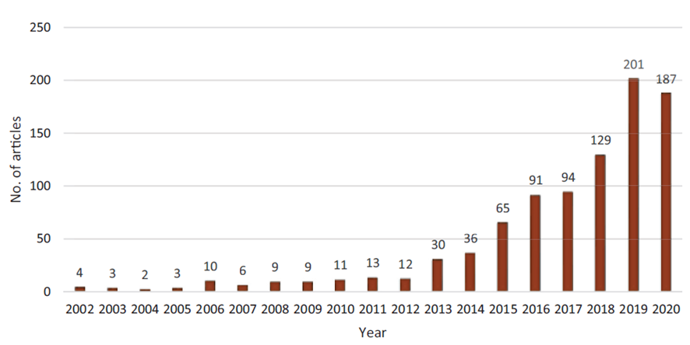
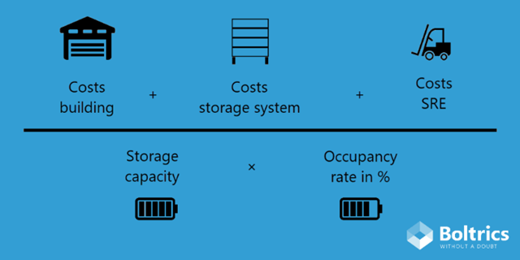
The Importance of Data-Driven Strategic Decision-Making in Logistics
Bogdan Dumitrășconiu, Mirela Octavia Sîrbu and Cristinel Vasiliu
PROVA NOV and The Bucharest University of Economic Studies, Bucharest, Romania.
bogdand@prova-nov.ro; mirela.sirbu@com.ase.ro; cristi_vasiliu@yahoo.com
This research examines the crucial role of data-driven strategic decision-making within the logistics sector. It aims to explore how logistics activities can leverage data to optimize resource allocation, improve operational efficiency, and achieve long-term competitive advantage.
A data driven solution is to use a combination of machine learning techniques and clustering techniques to predict the number of uncompleted services in last mile logistics. This prediction can help carriers increase their service levels without increasing the number of couriers and vehicles. The machine learning techniques are used to estimate the number of services that will remain uncompleted on a given route, while the clustering techniques are used to predict the routes to be followed by couriers and identify potentially uncompleted services as the last ones in each route.
Figure no. 1. Year-wise publications on DDQM in SCs
Business Intelligence is predicted to significantly impact the logistics sector, with a focus on data understanding for optimizing business processes and client needs. Occupancy Rate, defined as the percentage of warehouse capacity used, it is a crucial KPI. An ideal occupancy rate is between 85 to 90%, balancing efficiency and space for unexpected orders.
Figure no. 2. Calculating the costs of a pallet place
The research convincingly demonstrates a positive correlation between leveraging data and achieving superior logistics performance, identifying optimal cost mitigation strategies, leading to significant reductions in operational expenditures. This reinforces the notion that data-driven decision-making isn't merely about marginal gains; it can unlock substantial cost savings and improve a company's bottom line.
The current logistics landscape is undergoing a transformative shift, driven by the increasing importance of data analytics and AI. By embracing a data-centric approach, logistics companies can unlock new levels of efficiency, cost optimization, and customer satisfaction, ultimately securing a sustainable competitive advantage in the marketplace.

