Slide 1
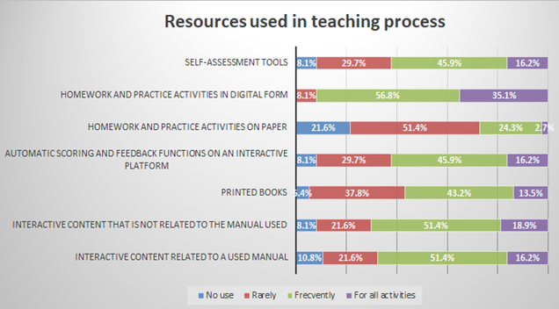
The COVID’s period - A shifting point in acceptance of online teaching for the academic community of the Bucharest University of Economic Studies Dina Răzvan, Lelia Voinea, Bogdan Georgescu, Dorin-Vicențiu Popescu and Teodor Mihai Negrea Bucharest University of Economic Studies, Bucharest, Romania rdina@ase.ro; lelia.voinea@com.ase.ro; bogdan.georgescu@mk.ase.ro; dorin.popescu@com.ase.ro; teodor.negrea@com.ase.ro
The COVID-19 pandemic has precipitated a notable shift in the adoption and acceptance of online teaching within the academic community of the Bucharest University of Economic Studies. This period served as a pivotal moment, compelling institutions to swiftly pivot from traditional face-to-face instruction to remote learning modalities. This paper examines the transformative impact of the pandemic on the educational practices of the Bucharest University of Economic Studies, focusing on the rapid integration of online teaching methodologies. Through a synthesis of empirical data and anecdotal evidence, this study elucidates the challenges and opportunities encountered during the COVID-19 period. It investigates the pedagogical approaches employed by faculty members to deliver engaging and effective online instruction, highlighting the role of technological infrastructure and institutional support in facilitating this transition. Additionally, it explores the evolving perceptions and attitudes towards online education among stakeholders within the institution. The COVID-19 pandemic has catalyzed a paradigm shift in the acceptance of online teaching within the academic community of the Bucharest University of Economic Studies, underscoring the resilience and adaptability of higher education institutions in response to unforeseen challenges. Research results show that after this period teachers are more open to teaching online, even if they prefer to recommend books in physical format and increasingly use online resources. In addition, e-learning is becoming a viable alternative for them.
In order to achieve the research objectives, exploratory research was performed, conducted online through a structured questionnaire uploaded on the free platform Isondaje.ro.
Results and Discussion

