Slide 1
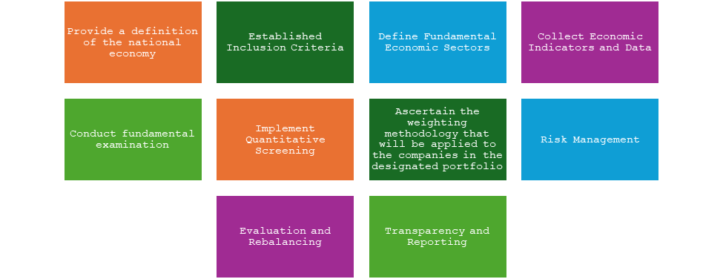
A Tool to Mimic Open Economies – Closed Investment Funds
Florina Bran¹, Dumitru Alexandru Bodislav², Romeo Catalin Cretu³ and Carina Ilinca Gombos⁴
¹⁾²⁾⁴⁾ Bucharest University of Economic Studies, Bucharest, Romania.
³⁾ University of Agronomic Sciences and Veterinary Medicine of Bucharest, Bucharest, Romania.
E-mail: florina.bran@eam.ase.ro; E-mail: alex.bodislav@ase.ro
E-mail: creturomeocatalin@yahoo.com; E-mail: carinagombos@gmail.com
Abstract
This study delves into the idea of a closed investment fund that manages to minimize risk while maximizing returns by replicating a country's economy across various sectors or industries. Using historical financial data and quantitative methods, the study creates a theoretical investment portfolio. Research indicates that focusing on specific sectors for hedging can provide a favorable risk-return balance in contrast to standard diversified funds. This research provides valuable insights for investment managers and investors looking for stable growth and risk mitigation in a dynamic economic environment. Researching closed investment funds that outperform stock market indicators is driven by the goal of finding investment opportunities that offer higher returns and potentially lower risk than traditional market investments. Efficiently allocating investment funds and implementing strong macroeconomic policies are essential for promoting long-term economic growth. The objective of investigating closed investment funds that surpass stock market indicators is to identify investment prospects that provide superior returns and possibly reduced risk in comparison to conventional market investments. In contrast to open-ended mutual funds and exchange-traded funds, closed investment funds are characterised by a limited number of shares and lack convenient exchange access, which results in operational distinctions. An examination of closed investment funds that maintain a superior performance to stock market indicators can offer investors significant knowledge regarding alternative investment approaches that could potentially improve the overall performance of their portfolios.
Keywords
Investment funds, growth, sustainable, efficiency.
For this paper, the research questions were categorized based on academic, business, and technical perspectives:
How does investing in closed investment funds with a proven track record of outperforming the stock market impact overall portfolio risk and return compared to traditional market investments?
What are the pros and cons of investing in closed investment funds, and how do these factors impact the attractiveness of these investments to different types of investors?
How can financial institutions meet this demand while successfully managing the related regulatory and operational obstacles?
Literature review
Prior scholarly investigations concerning closed investment funds that outperform stock market indicators have notable limitations, which encompass:
Data accessibility: Closed investment funds are more secretive in nature when compared to other types of funds, which complicates the process of obtaining comprehensive and dependable information regarding their performance and investment philosophies. This may potentially limit the scope and reliability of previous research.
Strict sample size: The limited number of closed investment funds that consistently outperform stock market indicators has had an impact on the sample size and statistical power of previous investigations.
Selection bias: By focusing on a limited subset of closed investment funds with a track record of outperforming the market, previous scholarly investigations may have erroneously assessed their performance.
Restrictions on generalizability: The applicability of findings from previous scholarly investigations regarding closed investment funds to different investment types or market environments may be limited.
Establishing a direct correlation between the outperformance of confined investment funds and their investment strategies may present a formidable challenge. Therefore, deriving definitive conclusions concerning the factors that contribute to their achievements becomes a formidable task.
Research methodology
By employing the quantitative method and mathematical models in conjunction with time-series data, economists examine patterns of economic development across discrete time periods. The growth drivers, such as levels of investment, gains in productivity, advancements in technology, and dynamics of commerce, are assessed by them. By understanding the factors that influence growth, policymakers are able to formulate approaches that foster sustainable and inclusive development. Additionally, the utilization of a quantitative approach enables a thorough assessment of the effects of various economic policies when evaluating their impacts. Using experimental or quasi-experimental methods, economists can estimate the effects of particular policies on economic growth, employment, poverty reduction, and environmental sustainability. Subsequently, policymakers will be able to refine interventions and prioritize those that yield the most substantial long-term sustainable development results.
In summary, policymakers cannot do without a quantitative approach to economic development, sustainability, and growth. By utilizing empirical data, evidence-based analysis, and mathematical models, it establishes a robust framework that facilitates the formula of effective policies, the attainment of sustainable economic development, and the guidance of the nation towards a future characterized by prosperity and sustainability.
Results and discussions
In order to enhance comprehension of the reasoning behind our company selection for the purpose of constructing a closed investment fund that emulates a national economy, we adhered to the subsequent methodology: Our research model, which has been an ongoing work for the past 12 years, consists of ten qualitative steps:
Conclusions
Through the experimentation of different models, we ascertained that the outcomes we achieved and the hypotheses we pursued all converged on the notion of decision automation (defined as the automatic execution of decisions by means of predetermined algorithms, but predominately based on generating the notion of accessing only a limited number of paths to follow and facilitating proactive flow in the work process). Decision automation is a critical element in mitigating the adverse externalities induced by black swan-like occurrences. It is an intrinsic component of the knowledge flow circuitry that has been acquired through the quantum revolution. This is due to the perception that information functions as an intermediary flow with a multitude of possible destinations, contingent upon the objectives of the user (e.g., first world countries developing extremist policies, global terrorism, natural disasters, or economic crises). An objective of this study is to draw parallels with the healthcare sector, and the findings validate that both industries are exhibiting a comparable trajectory. We will not know with certainty what will occur to supply and demand until the trend completely reverses, as the global economy is still undergoing a macro-trend of historical economic development that appears to be ending its Kondratieff cycle.

