Slide 1
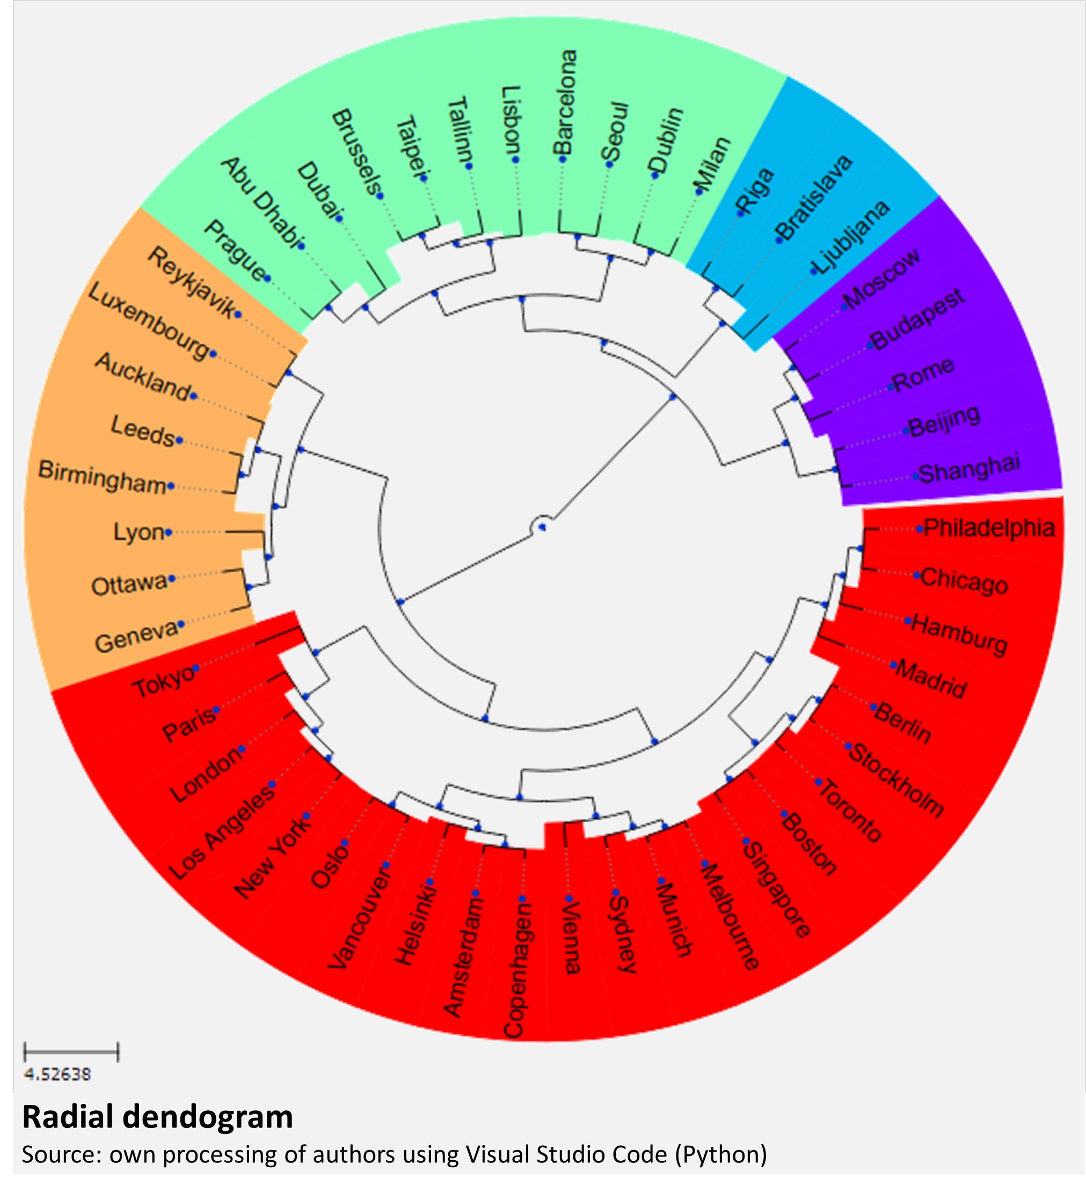
Smart City and Urban Sustainability
Emilia Țițan¹, Giani-Ionel Grădinaru², Daniela-Ioana Manea³ and Mihaela Mihai⁴
¹⁾²⁾³⁾⁴⁾ Bucharest University of Economic Studies, Bucharest, Romania.
¹⁾²⁾³⁾⁴⁾ Institute of National Economy, Bucharest, Romania
emilia.titan@csie.ase.ro; giani.gradinaru@csie.ase.ro; daniela.manea@csie.ase.ro; mihai.mihaela@csie.ase.ro
Abstract
Exploring the concepts of smart city and urban sustainability has become a necessity in addressing the complex challenges of modern urbanization. As new technologies emerge, cities around the world are opting to transition to a smart city, but without giving up on sustainability, understanding how these two concepts intertwine is essential to shaping future urban development.
The symbiotic relationship between smart city technologies and urban sustainability goals will be investigated through a cluster analysis based on composite indices: Smart City Index, Happy City Index, Quality of Life Index and Innovation City Index. By including cities in distinct clusters, the study reveals varying degrees of integration between technological advances and sustainability practices. The results show that cities can be grouped into specific categories that reflect their success in harmonizing digital technology implementations with sustainability goals, showing that a balanced approach to the two concepts can lead to high living standards and robust sustainability outcomes.
This study is distinguished by introducing an innovative classification framework that provides a different perspective on the interaction between smart cities and sustainability using an analysis based on composite indicators. This framework highlights the diverse strategies adopted by cities despite these challenges, underscoring the need for a balanced urban development strategy. Such an approach promotes not only technological progress but also progress in environmental sustainability and improving the quality of life, thus providing a model for cities that want to adapt to the needs of the current era.
Based on the results of the cluster analysis, the dendrogram illustrates how these cities can be grouped together based on their measures of sustainability and innovation, thus providing insight into how different cities compare and collaborate in the global context of smart cities and urban sustainability.
Using data on cities around the world for which data are available on the indicators included in the analysis, Smart City Index, Happy City Index, Quality of Life Index and Innovation City Index, statements can be made for each cluster in the context of smart cities and sustainable urbanism:
• Green cluster: includes cities located in Europe and Asia, illustrating a mix of Western and Eastern European cities, as well as major cities in the Middle East and East Asia. This reflects the cultural and economic diversity within the cluster and the wide potential for knowledge exchange and innovative practices between these regions.
• Blue cluster: includes Bratislava in Slovakia, Ljubljana in Slovenia, and Riga in Latvia. The European cities in this cluster present a balanced approach between two analysed dimensions: the adoption of technologies in the smart city and their positive effects on the quality of life.
• Purple cluster: includes Beijing, Budapest, Moscow, Rome and Shanghai, cities with a rich historical and cultural past, combining their unique heritage with ambitions for modernization and innovation.
• Red cluster: includes cities spread across the globe and recognized for their dynamism, high quality of life, and innovative environment.
• Orange cluster: includes cities located both in Europe and North America as well as in Oceania, which may suggest a possible regional trend toward innovative smart city policies and a high quality of life. Simultaneously, smart and sustainable cities represent a global priority, regardless of the geographical region.
The data and cluster analysis results suggest that cities can be grouped into distinct clusters on the basis of their performance in sustainability and digital technologies. Each cluster identified in the dendrogram brings together cities with similar performance profiles in the analysed indices, which indicates a similar approach or results in the implementation of sustainability and smart technology solutions. This fact confirms the first research hypothesis (#1) that cities can be grouped into distinct clusters based on their performance in the dimensions of sustainability and implementation of digital technologies.
At the same time, there are significant variations in the performance of cities in terms of sustainability and smart technology by geographic region. The dendrogram might reflect this variation, with cities in certain regions tending to cluster together. This may be due to cultural, economic, political, and historical factors that influence how actively a city invests in innovation and sustainability, which confirms the second research hypothesis (#2) The performance of cities in terms of sustainability and smart technology varies significantly depending on the geographical region.
Smart urbanism and digital participation are two key concepts in the evolution and optimization of contemporary urban spaces, combining technology and the active involvement of citizens to achieve the goals of sustainable and efficient urban development. Smart urbanism is defined as the application of advanced technologies such as the Internet of Things (IoT) and data analytics to manage and optimize urban resources, including transport, energy and public services (Bibri and Krogstie, 2020). This approach results in a connected urban ecosystem where infrastructure interacts synergistically, having a significant impact on the quality of life of residents and environmental sustainability.
Digital participation is an essential pillar in the decision-making process at the urban level. This involves the use of online platforms, mobile applications and social media to facilitate dialog between citizens and authorities, thereby promoting transparency and inclusiveness in the decision-making process. Citizens become active participants in gathering information, providing feedback and developing suggestions for urban projects, thus helping to shape urban planning according to the needs and expectations of local communities (Bouzguenda, Alalouch and Fava, 2019).
The effective integration of smart urbanism and digital participation is an essential step in building cities that provide an inclusive and sustainable living environment (Komninos et al., 2019). This approach not only maximizes the benefits of technology in urban planning, but also strengthens the links between citizens and decision-makers, promoting effective and accountable urban governance. The synergy between these two concepts represents an essential foundation for the evolution of cities in the context of a constantly changing digital world.
Conclusion
In a world of continuous urbanization and digitization, composite indicators measuring the performance of cities in aspects such as technological innovation, citizen happiness, quality of life, and urban innovation capacity are becoming essential tools for urban planning and policy development. The present study focuses on the interpretation of four such composite indicators: the Smart City Index, Happy City Index, Quality of Life Index, and Innovation City Index, each reflecting a vital dimension of urban progress and well-being. By comparing the performance of cities in these areas, the leaders in urban innovation can be identified, and the cities in which these aspects can be improved can be highlighted.
In this context, different models of success and challenges in the evolution of urban sustainability can be observed:
Auckland and Geneva perfectly exemplify the balance between technological advances and a high quality of life, indicating a strong commitment to sustainability and urban responsibility (Mega, 2022).
The major urban agglomerations, Tokyo, London​​​​​​​ and New York, illustrate how metropolises combine new technological breakthroughs and urban infrastructure with the goals of sustainability and improving the quality of life (Shmelev and Shmeleva, 2018), while other large cities, such as Paris, highlight the areas that can be optimized, resulting in improved quality of life.
Abu Dhabi and Seoul focus on developing advanced technological infrastructure and stimulating innovation, but require improvements in quality of life and dimensions quantified by the happiness index, suggesting the utility of a holistic approach to urban balance (Noori, Hoppe and de Jong, 2020; Al-Azzawi, 2021).
Similarly, Beijing and Shanghai demonstrate a strong commitment to urban innovation, but lower values for the Quality of Life Index highlight the need to balance rapid growth and innovation with improved living standards to ensure urban sustainability (He et al., 2018).
The results of this study are influenced not only by the availability of data but also by the complexity of each composite indicator included in the analysis. Thus, one of the limitations of this study is its dependence on publicly available indices (Smart City Index, Happy City Index, Quality of Life Index and Innovation City Index) for the classification of cities. At the same time, these indices are sensitive to point analysis, and there is a risk that they do not always reflect the local nuances specific to each city or exclude emerging factors relevant to urban sustainability and smart technologies (direct civic participation in smart city initiatives etc.). To overcome this limitation, a future research direction could include collecting more detailed data, including at the local level, which will provide a clearer insight into the effects of smart and sustainable city initiatives. Depending on the availability of data, added value can be provided by integrating a longitudinal perspective, thus tracking the evolution of smart cities and their sustainability over time to identify trends and assess the impact of long-term interventions. Such research could provide richer and more useful insights for urban innovation policymaking, helping to create smarter and more sustainable cities for the future.

