Slide 1
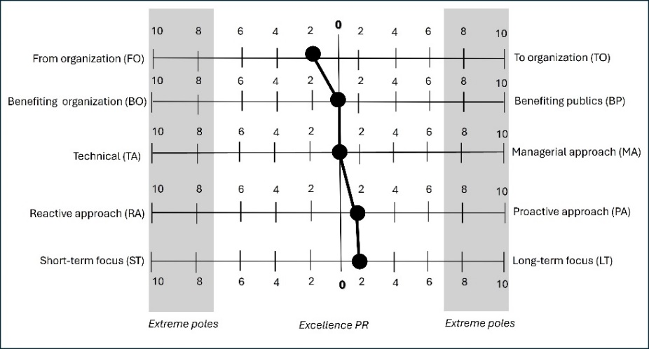
Strategic Communication for Ecotourism – a public relations approach
Mihail Ovidiu Tănase¹ and Andreea Roxana Răceanu²
1) Bucharest University of Economic Studies, Bucharest, Romania.
2) National School of Political Science and Public Administration, Bucharest, Romania.
mihail.tanase@com.ase.ro ; andreea.raceanu@comunicare.ro
Communication is an important dimension in tourism activities, both in terms of implementation and promotion. Especially in the area of sustainability, communication can play an essential role. The new challenges present in tourism and environmental issues call for an extended communication approach, focussing on responsibility and cooperation, as important coordinates, beyond the traditional usage of communication in the form of marketing and advertising, The present paper is the first one to focus on ecotourism through the lenses of PR, as a strategic communication process.
The research objectives are addressed in the form of a case study, using a qualitative methodology to investigate the activities of the Association of Ecotourism in Romania (AER). AER is a well-known association, created in 2008, and is a central actor in the promotion and development of ecotourism in Romania. With a wide range of members, from experts in tourism and service providers (travel agencies, accommodation units, experience providers) to nature conservation and sustainable development organizations, AER has implemented in the past years more than 35 projects with national or international funding. The main areas of focus for AER are promotion and marketing, strategic and product development, and certification in ecotourism.
Aiming to extract valuable conclusions regarding ecotourism implementation, the research questions of the present study are further introduced. (RQ1): Which are the technical PR coordinates of AER communication for supporting Romanian ecotourism (organizational and functional dimensions, communication planning, designated responsibles)? (RQ2): What type of PR did AER apply in its activities for supporting ecotourism in Romania? Initiated as pilot research illustrating the use of PR in ecotourism, this article takes the form of a case study focussing on the activity of the main association supporting ecotourism in Romania. The reasons for this choice are linked to the complex country offers in the area of ecotourism (in terms of both nature and culture) and considering the numerous positive outcomes of AER for ecotourism over the years at the national level, and its international visibility.
The study is based on qualitative research, using mixed methods: secondary data analysis and an in-depth interview. Secondary data selected consist of official regulation documents, online content, and traditional and online communication channels. This involved: (1) official government papers on the Romanian strategy for ecotourism development (Governmental Decision regarding the approval of the National Ecotourism Development Strategy - context, vision and objectives - 2019-2029; National Strategy for Ecotourism Development - context, vision and objectives, 2019-2029), (2) 20 AER publications to promote and implement Romanian ecotourism (AER, 2012), 37 press releases (AER, 2023) and 11 annual reports (AER, 2020a) and (3) AER two online platforms that are dedicated to ecotourism providers in Romania and its national and international audiences (AER, 2020b; 2021). The interview was conducted with AER management, to access in-depth information beyond public data and to explore the motivation, limitations, and practical implementation of activities that contributed to the development of ecotourism in Romania.
The methodological instrumentary was based on the five scales proposed by Laskin (2012) to analyse PR activity, each with its pair of opposing poles: (1) communication direction - two-way or one-way (from the organisation – FO / to the organisation - TO), (2) intended beneficiary – symmetry/asymmetry (organisation – BO / public - PO), (3) role of practitioners and their approach (technical – TA / managerial- TA), (4) strategic nature approach (reactive – RA / proactive - PA), and (5) timeframe (short-term focus – ST / long-term focus - LT). With the use of these five scales, the AER PR activity was analysed, to investigate its correspondence with the theoretical excellence model in PR (Grunig, 2013). As indicated by Laskin, codes from 0 to +10 were attributed to each of the five scales on each of their sides, to mark the position between their opposing poles and the central position. The extreme positions (from +8 to +10) indicate the dominance of one of the poles. The central positions (between +2 to +2) illustrate the PR excellence practice, with the balanced position centred on 0.
Results and discussion
Organic unintended PR implemented by AER - The research revealed that although AER does not have formal dimensions for the implementation of PR, it uses this type of communication organically, to the benefit of its public in Romania and internationally. The association is small, with limited budget, mainly provided by its members and the projects it accesses, with external funds. There is no dedicated PR or communication department and neither is an assumed integrated communication plan. According to the response of the AER representative during the conducted interview, 'communication is a prospective area, to be developed during the next period’.
Excellence PR –
The research showed a central, balanced approach for the first dimension analysed, communication direction, with a light orientation toward the public information model (disseminating content and output) rather than listening to the public. This is natural, considering that AER has played a central role in ecotourism in Romania over the years, as an expert and legitimate actor in initiating change and spreading information and knowledge.
Regarding the beneficiary scale, the AER communication shows a balanced approach. Promotional and technical content, together with direct presentations to actual and potential ecotourism providers, indicate a slight public interest-orientated approach (PO2). General content is useful to the public, but also contributes to the reputation of AER.
The role scale indicates a clear balanced approach. This is natural considering that the association has a small team and the fact that people taking decisions and participating in AER activities (including internal and external communication) held managerial positions in the association and have extensive expertise in the area of ecotourism and its main coordinates.
The scale of strategic nature indicates for AER communication and activity a slight orientation toward a proactive approach, on most of the indicators and sub-indicators. The area of policy dialog is rather reactive, which is due to the role of AER as an actor participating in public consultation and discussions initiated and coordinated by the authorities. In the case of events, meetings, and working groups, the results show a balanced approach, considering the partenerial role of the association in organising and implementing such activities. For all others, the AER activity is slightly geared toward a proactive approach.
On the time-frame scale, there is a slight orientation toward long-term results, especially in the case of promotional content, implementation of ecotourism policies, research substantiating ecotourism activities, and contributing to direct and indirect training for ecotourism providers. These include providing specialised consulting and offering support in developing and implementing interpretive trails and visitor centers.
Figure no. 1 . AER activity and communication for Romanian ecotourism, according to PR scales
Source: authors’ own processing, based on the conducted study
Scale positioning Indicator | Comm. direction |  | Intended beneficiary |  | Role of practitioners |  | Strategic nature |  | Timeframe
 | FO | TO | BO | PO | TA | MA | RA | PA | ST | LT
Providing promotional content | 2 |  |  | 2 | 0 |  |  | 2 |  | 2
Providing technical content & support | 2 |  |  | 2 | 0 |  |  | 2 | 0
Disseminating general content (AER website, Eco-Romania portal, press releases, interviews) | 2 |  | 0 |  | 0 |  |  | 2 | 0
Offering direct presentations and counselling to providers | 2 |  | 0 |  | 0 |  |  | 2 |  | 2
Active participation in policy dialog | 0 |  | 0 |  | 0 |  | 4 |  |  | 2
Conducting research on ecotourist profile |  | 4 | 4 |  | 0 |  |  | 2 |  | 2
Participating in events, meetings, working groups & designing/conducting evaluation | 0 |  | 0 |  | 0 |  | 0 |  | 0
communication type | FO 2 |  | balanced |  | balanced |  | PA 2 |  | LT 2
Conclusions
Although AER does not have a formal framework for applying PR and does not intend to use it in its activities, the study illustrates an organic manifestation of this form of communication. Using a qualitative methodology based on a five-scaled analysis for PR implementation, the study shows that AER uses the PR excellence model to integrate the three pillars of ecotourism.
Table no.1. Indicators of AER activity in supporting ecotourism and their value on the 5 PR scales

