Slide 1
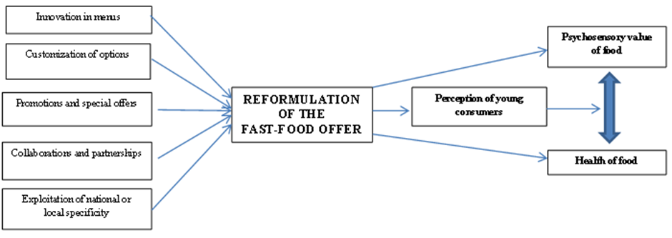
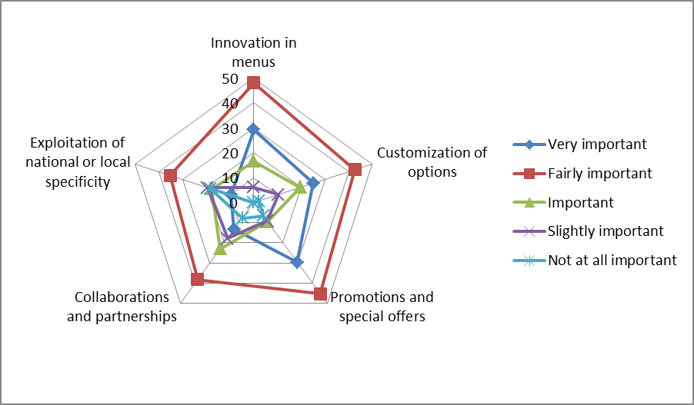
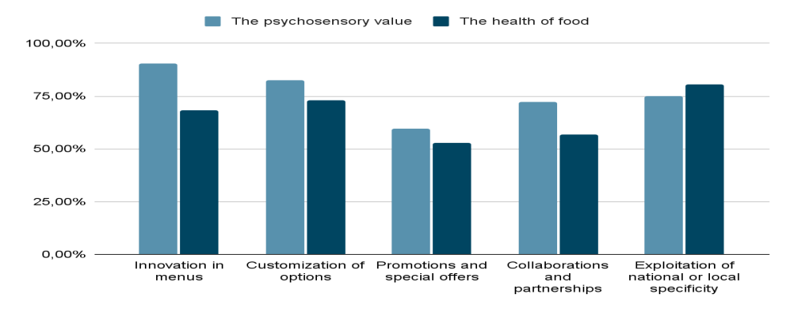
Title: Fast-food Is Everywhere: Does Offer Reformulation Influence Young People's Perception of the Relationship Between Psychosensory Value and Health?
Authors: Roxana Procopie and Magdalena Bobe
Affiliation: Bucharest University of Economic Studies, Bucharest, Romania
Email: roxana.procopie@com.ase.ro; E-mail: magdalena.bobe@com.ase.ro
Abstract
Economic and lifestyle changes, increased buyer incomes, and technology have gradually led to the modification of fast-food consumption. This article explores the actual evolution of fast-food offer and how they have been reformulated within the new socio-cultural paradigm to encourage purchases by exploiting customers' sensory and emotional experiences, promoting the idea of healthier options. However, there may be potential divergences between the reformulation of fast-food offer and the perception of the taste-health relationship, as well as between its promotion and consumer behavior. To what extent does the reformulation of fast-food offer shape the behaviors of young consumers and alter the perception of the relationship between psychosensory value and health of food? The answer to this question is the objective of our quantitative exploratory research; the results demonstrate a direct and positive influence of fast-food reformulation on the perception of the link between what is healthy and what is tasty and attractively presented. However, this perception is often mistaken because the reformulation of offer rarely leads to an improvement in the nutritional profile of foods or the enhancement of cultural content. Furthermore, the development of multichannel food marketing has raised new concerns regarding public health and particularly the diet of young people, legitimizing our scientific endeavor as exploring the perceptions and attitudes of young buyers towards new fast-food options provides insight into the impact on sales and profitability in the fast-food industry on one hand, and on the satisfaction and loyalty of a conscious, responsible, and nutritionally educated consumer on the other.
Keywords
reformulation of fast-food offer, relationship between psychosensory value and health, perception of young consumers, psychosensory value and health of food
Introduction
Current research highlights that food marketing affects young consumers’ nutrition knowledge, food preferences and consumption patterns, that the foods promoted by food marketing represent a “very undesirable dietary profile, with heavy emphasis on energy dense, high fat, high salt and high sugar foods” (Cairns et al., 2009). According to WHO (2023) “unhealthy diets are a leading global public health risk, contributing to all forms of malnutrition”, and food environments, which include food marketing, are recognized as one of the key influences on diets. Other research (Boyland and McGale, 2022) reinforced these findings, and the advent and growth of multichannel marketing have raised new concerns regarding the relationship between preferences, beliefs, and attitudes.
It is recognized that psychosensory value is the fundamental attribute of fast-food offer that leads to a top culinary experience and consumer satisfaction (Zhang et al., 2019). However, few studies have addressed the combined effects of the attributes conferred by the reformulation of fast-food offer on behavioral intention and the perception of the relationship between psychosensory value and food health.
Since a large part of young people perceive healthy eating as an integral part of mental and physical health (European Institute of Innovation & Technology, n.d.) and consider it difficult to eat healthily, especially outside the home, the fast-food industry has tried to capitalize on these beliefs and has had to undergo significant transformation by reformulating its offer to promote new sensory and affective experiences. Building on the idea that more and more young people seek satisfaction in consumption and exploiting the desire for full enjoyment of fast-food at the intersection of sensory pleasure and situational comfort (Bauman, 2007), the purpose of our work focuses on studying the influence of fast-food reformulation on the eating behavior of young people regarding the relationship between the psychosensory value of food and food health.
Our approach is based on exploratory quantitative research among young people, and the results are beneficial for shaping guidelines and measures for the nutritional education of young people, as well as feasible strategies for improving the nutritional quality of fast-food offer. All these can contribute to healthier choices, both for forming synesthetic experiences and for improving the eating behavior of young people.
1. Review of the scientific literature - the reformulation of fast-food in the context of the new socio-cultural paradigms of consumption
Studying the history of fast-food, we can observe that the first signs of changes in public awareness regarding the nutritional impact and the necessity of reformulating offer bring to the forefront initiatives to reduce ingredients with negative health impacts. Over time, fast-food has cultivated loyalty through sensory attributes and relational benefits (Dandis et al., 2023; Hassan et al., 2023), The reformulation of offer in the fast-food industry under the new socio-cultural paradigm does not only refer to the introduction of healthier options but also to the adoption of creative strategies to attract a wider consumer segment and maintain the loyalty of existing ones (Mifli et al., 2015; Chun and Nyam-Ochir, 2020; Giachino et al., 2021; Li et al., 2022; Ibáñez-Sánchez et al., 2022; Magbanua et al., 2023):
- Innovation in menus - by introducing new and interesting products or unique and uncommon ingredients, expanding the menu to cater to diverse preferences and diets, including vegetarian and vegan options, gluten-free products, or healthy alternatives to traditional fast-food items.
- Customization of options - customers can choose desired ingredients to create their unique product combinations, offering a more interactive and personalized experience.
- Promotions and special offers - that may include discounts on certain products or attractive deals, effective strategies during low sales periods or to promote new or less popular products.
- Collaborations and partnerships with other brands or public figures - may involve launching limited editions or special collections of products in collaboration with popular brands or food influencers.
- Exploitation of national or local specificity - involving adapting food offer and marketing to reflect the culinary preferences and local culture of a particular region or country:
Local variants of popular, authentic products adapted to the tastes and dietary preferences of a specific region, ingredients, or traditional local recipes that are familiar and appealing to consumers.
Partnerships or collaborations with local producers to obtain fresh and authentic ingredients, supporting the local economy and improving the quality of the products offered.
Localized marketing, advertising campaigns, and promotional materials that specifically address the preferences and eating habits of the local population, organizing events or offering promotions during local holidays or festivals.
Customization of restaurant designs according to local specificity through themed decorations or architectural elements that reflect the traditions and culture of the respective region.
2. Research methodology and Model
In order to fulfill the objective of this paper, our research investigates how the reformulation of the fast-food offer through five creative strategies - innovation in menus, customization of options, promotions and special offers, collaborations and partnerships, exploitation of national or local specificity – influences customers' perception of the psychosensory value-healthiness relationship of foods. The conceptual research model is suggested in figure 1.
3. Results and discussion
Socio-demographic differences are an important predictor of fast-food consumption. Lower socio-economic status (in terms of education level and income) is the most significant risk factor for consuming unhealthy foods (d'Angelo et al., 2020), along with other important factors such as age, gender, and frequency of fast-food consumption.
Following the delineation of the socio-demographic profile of consumers (women, aged 18-25, with university education, earning between 2001-3500 lei monthly, and who frequently consume fast-food) was identified the importance given to the five strategies for diversifying the fast-food offer to consumers, the results indicating that the majority consider them fairly important, ranking first innovation in menus (48.1%), promotions and special offers (45.3%) and customization of options (42.6%), followed by collaborations and partnerships (38.3%) and exploitation of national or local specificity (35.1%) (Figure no.2).
The data processing indicated that young people perceive the reformulation of fast-food offer as an improvement in predicting increased demand, as it significantly influences the psychosensory value and health of these foods. This explains that interventions in restructuring offer, accompanied by effective promotion and strong food marketing, are efficient as they involve making active, heuristic decisions (d'Angelo et al., 2020), based more on emotions and less on reason.
A large portion of the respondents (86%) showed a tendency to change their eating habits after being heavily exposed to fast-food advertisements, which they found very appealing, boosting the consumption of these foods and further encouraging repeat purchases.
Regardless of the strategies for reformulating the fast food offer referred to, they are perceived as having a direct connection, both with increasing the psychosensory value of the food and their health status, simultaneously (Figure no. 3), so the reformulated offer is perceived by young people as both tasty and healthy.
Research on the importance of the psychosensory value of fast-food products involved assessing organoleptic characteristics, and the results indicated that the sensory experience focuses on taste, smell, visual appearance, and texture/consistency, in that order of importance. The perception of increased psychosensory value of reformulated products compared to classic ones is positive, as is the perception of the healthiness of reformulated foods defined by nutritional quality, safety, and ingredient quality. The correlation is used to verify the validity of the first two hypotheses:
r1=0.87 represents the correlation coefficient between the reformulation of fast-food offer and the psychosensory value of the products, with the result indicating a very strong positive correlation; according to the results presented above, hypothesis H1 is validated.
r2=0.58 represents the correlation coefficient between the reformulation of fast-food offer and the healthiness of the foods, with the result indicating a moderate positive correlation, which validates hypothesis H2.
By concatenating and processing the data obtained, it can be observed that young consumers have a good perception and perspective on the relationship between the psychosensory value and the health of food determined by the reformulation of the fast-food offer, which validates hypothesis H3, regardless of the strategy chosen by the company.
However, we believe that this perception is not always accurate, as the reformulation of fast-food offer rarely leads to the provision of healthier and more sustainable alternatives. The promotion of reformulated fast-food offer, from the producer's perspective, highlights, through advantageous visual cues, the characteristics of "new/authentic/natural/popular/local/national," which younger generations perceive as "progress." Indeed, the ideological influence it implies is yet another reason to expect further acceleration in demand, as the relationship with consumption defines the relationship with the society we live in (Ritzer and Miles, 2019). Furthermore, the marketing strategies used by fast-food chains perpetuate and exaggerate the perception of the relationship between psychosensory value and food health towards a distorted conception.
The reformulation of fast-food offer focuses on menu innovation but is supported by other factors such as pricing strategies and new restaurant formats, the development of digital technology, and the expansion of food delivery platforms. One key aspect of this phenomenon is the manipulation of sensory attributes to create the illusion of healthfulness.
Figure no. 1. Research Model
Source: our research
Conclusions
This paper was designed to gain a better understanding of the perception of the psychosensory value-health relationship on reformulated fast-food offer through various means. Thus, to fulfill the main objective of the paper, five creative strategies were identified - innovation in menus, customization of options, promotions and special offers, collaborations and partnerships, exploitation of national or local specificity- which shape the context of reformulating offer and have been integrated into the research model.
Fast-food has become an integral part of modern society, with its ubiquitous presence shaping not only the diets of young people, but also their perceptions of health and psychosensory value. The research results demonstrate that reformulating fast-food offer through the creative strategies outlined can create the illusion of healthier choices among young people, ultimately perpetuating a mistaken perception of the relationship between health and psychosensory value. To produce significant changes in eating behaviors and improve health outcomes, stakeholders need to adopt a multifaceted approach that addresses both individual choice determinants and public health determinants.
Reformulating fast-food offer, along with marketing efforts, could promote healthier eating habits if interventions by health organizations and governments focus on increasing consumer awareness of health issues, as well as the perception and effectiveness of nutrition standards. The reformulation of fast-food offer should integrate the transfer of scientific and technological knowledge as sources of nutritional enrichment; to further exploit local raw materials and ingredients, traditional dishes adapted to modern requirements; to rediscover the cultural value of food, considering the social, health, and economic consequences of the current food system for young consumers.
This study has certain limitations due to the short duration of the data collection process, resulting in a small sample size, with the research relying on 104 questionnaires. Additionally, the results could have been enhanced by a comparative sensory analysis between classic and reformulated products, which would have required substantial human, financial, and material resources.
The intensive promotion of fast-food seeks to shape consumer perceptions and behaviors—an objective that is both enticing and ubiquitous; much of the previous research starts from the idea that marketing is based on emotional and cognitive associations and approaches fast-food marketing on the premise that media discourses reflect and contribute to culture (Otto, Johnston, and Baumann, 2022), recognizing that fast-food incorporates aesthetic, social, cultural, and economic dimensions (Warde, Paddock, and Whillans, 2020). The results of our study can guide future research because little is known about the effects of promoting reformulated fast-food offer on emotions and behavioral intentions (Diaz-Beltran, 2023), especially among consumers concerned about their well-being and health.
Figure no. 2. The importance of fast food offer reformulation strategies
Source: our research
Figure no. 3. The perception of fast food offer reformulation on the psychosensory value and health
Source: our research

