Slide 1
Public policy in the areas of environment and energy
Dumitru Alexandru Bodislav, Carmen Valentina Radulescu, Florina Bran and Sorin Burlacu

Slide 2
Introduction
The title of "medium" was introduced in 1987 by the Single European Act, having as objectives:
Conservation of environmental quality
Protecting human health
Ensure a rational use of natural resources and their conservation
The environmental policy is based on four principles:
The precautionary principle that represents an intervention instrument when there is uncertainty about a factor that can affect human or environmental health, coming from an action or policy, the measures being non-discriminatory and proportional to the problem, from this principle deriving from the other three:
Prevention
Correction
The "polluter pays" principle by which measures are applied when the prevention or remediation of problems arises. For example, those dealing with the transport of hazardous substances, which are discharged to their destination in natural environments, will take preventive measures in case of imminent dangers to the ecosystem, having to bear the related expenses (Bran et al., 2018).

Slide 3
Introduction
The EU climate energy package involves the following:
20% reduction of EU greenhouse gas emissions compared to 1990 levels;
20% improvement of EU energy efficiency;
20% of EU energy comes from renewable sources (wind, solar, biomass, etc.)
The role of this package is represented by:
These "20-20-20" objectives are aimed at combating climate change, increasing the EU's energy security and enhancing its competitiveness. These are also key objectives of the Europe 2020 strategy for smart, sustainable and inclusive growth (Profiroiu et al., 2019).

Slide 4
2020 action plan of the European Commission
The European Commission and the European Parliament have launched an action plan for 2020 by 2013, which involves protecting nature, increasing ecological resilience, sustainable long-term growth and efficient use of resources, stimulating the reduction of carbon dioxide consumption, The "Sustainable Development Strategy (SSD)" was an answer to these needs, being formulated in accordance with the "Lisbon Strategy" internationally, in 2006 being revised and adding the internal dimension that aims to promote unemployment and create an environment with new jobs, this leading to increased human well-being, environmental protection and cohesion (Androniceanu et al., 2017).

Slide 5
2020 action plan of the European Commission
Also, the "Aarhus Convention" represented a multilateral environmental agreement, which implies that the European Union and all the Member States give the public the 3 rights of involvement:
The right to information about and about the environment, information held by the authorized authorities
The right to participate in decision-making on environmental issues
The right of access to justice in case of violation of the other two
The implementation of all policies is part of the national, regional and local environment (Negescu Oancea, et al., 2019). One of the major problems of the ecosystem is the fight against climate change, an area that has always been a priority for energy and environmental policies (Angheluta et al., 2019).
Taking into account the current situation of heating with values ​​between 1 ° C and 6 ° C, due to the massive deforestation, the burning of fossil fuels and the activity of agriculture, we need new additional policies. According to the "Stern" report, the cost of action against climate change would cost 1% of world GDP annually, generating a higher level of health and rational energy use (Jianu et al., 2019). Also, the cost of inaction could be between 5% -20% of world GDP annually.

Slide 6
2020 action plan of the European Commission
Types of changes:
Water rationalization
Crop rotation
Use of drought resistant crops
Planning and public awareness.
The "Paris Agreement" aims to establish efforts to maintain global average temperature rises, trying to maintain above average pre-industrial levels by 1.5 ° C. Thus, the first half of this century should be reduced greenhouse gas emissions, in the other half to reach the target of 0. The support will come in the case of underdeveloped countries and island states, this support being of a financial nature but also in the field of quality improvement (Rădulescu et al., 2018).

Slide 7
Energy policy
Energy policy is a challenge of the European Union which concerns issues such as the continuous increase of import dependency, limited diversification, the energy market in terms of price increases and their volatility (Bodislav et al., 2019). This policy pursues measures to achieve an integrated market and ensure security of supply in order to extend the sustainability of this sector (Burlacu et al., 2019).
The main objectives of this policy:
Ensuring an internal energy market and interconnection in the sector
Secure energy supply
Energy efficiency and conservation
Decarbonizing the economy in accordance with the "Paris Agreement"
Promoting the renewable energy sector
Promoting the technologicalization in the sense of allocating the resources necessary for the research-development, creating a competitive environment

Slide 8
The case of Romania
It seems that in Romania, the current problem is represented by the management of waste, thus the problems encountered at the level of environmental policy implementation (EIR) are identified according to the European Union legislation as follows:
Improving compliance with the legislation on waste and urban waste water
Improve coordination and strengthen the administrative capacity of the competent authorities and agencies in the application of the legislation
Three issues discussed in July 2018:
Waste management
Waste water
Improving air quality
Thus, following the low levels compared to the predictions presented in the report for 2017, Romania is in a position not to reach its 2020 targets by 50%.

Slide 9
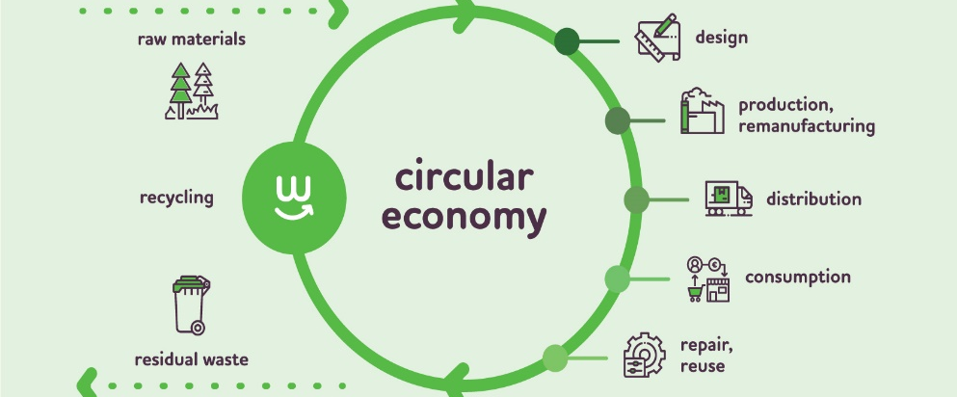
Figure 1. Circular economy

Slide 10
The case of Romania
Water quality problems have always existed, according to the Accession Treaty, Romania had to apply the water treatment directive to increase the degree of drinking water and the quantity of drinking water. The lack of administrative capacities and the lack of theoretical and technical knowledge in the field make the Natura 2000 network affected, nature conservation being a major problem of Romania. The energy and transport sectors decrease air quality by using fossil / solid fuels at household level, some of the measures being (i) optimization and restructuring of the energy system, this being possible by creating new types of renewable sources and switching to natural gas; (ii) limiting crowded traffic; (iii) other measures to control and prevent pollution.
The circular economy of Romania represents a weakly developed sector, "confirmed by the authorities in a conference on this topic in the autumn of 2017". Also, productivity of resource utilization was among the lowest, together with Bulgaria and Estonia, about 0.33 EUR / kg (EU average 2.04 EUR / kg). The "polluter pays" principle is one of the recommended measures, as well as subsidizing the recycling sector.

Slide 11
The case of Romania
The growth rate of employees in the environmental field increased between 2011 and 2016 from 130,000 people to 164,358 people, this increase being followed by a decrease in 2017 to 147,710, according to specialized studies. Although Romania has access to European funds and other support measures for the environment sector, the most developed measures are applied by third-party organizations. It seems that these implications expressed through indicators are important in demonstrating the awareness of the transition to the circular economy. By the end of 2018, Romania had 24 products and 19 licenses registered in the European eco-labeling system, out of a total of 71,707 products and 2,167 licenses at EU level.
When we talk about the efficiency of the SMEs, we consider the low level of awareness and the need to comply with the regulations in the environmental practices, we notice that the increase of the awareness level is given by the big investments of the powerful financial companies to develop the degree of reconciliation. The eco-innovation indices are to be noted that Romania ranked 27th in the scoreboard, accompanied by the score of 18 percentage points, an increase over 2010. All these results are the result of energy saving measures and reduction measures at minimum of waste, the weak point being the lack of investments in the annual turnover for the efficient use of resources.

Slide 12
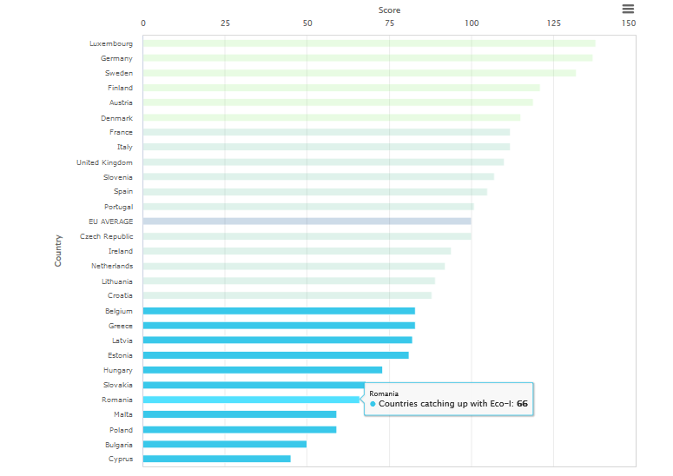
Figure 2. Eco-Innovation action plan

Slide 13
The case of Romania
The actions for the future are:
Ensuring the specific political framework, promoting a sustainable strategic vision and an effective approach for integrating sustainable development
Increased support, especially through education and training.
And the waste management rate is a challenge of Romania, according to the complete implementation of the policies and the Union legislation in the field of waste. The recycling rate stagnated in 2013, but we observed an increase in incineration, the rate of waste disposal in 2017 being 70%, all being expressed as municipal waste per capita (272 kg in 2017).

Slide 14
Conclusion
The ecosystem needs policies and strategies for the development and improvement of green infrastructure, Romania having to create a country page on biodiversity through the European Information System, this contributing to the evaluation of the European Union Strategy in 2020. All of these are aimed at creating green partners. in urban areas and green belts around cities. They also include the estimation (i) of the natural capital in which Romania has made progress in 2016 and 2017, through commercial and biodiversity platforms, (ii) identifying invasive alien species, controlling or eradicating the priority and managing biodiversity disturbance, (iii) ) protection of the soil which represents an extremely fragile finite resource, but (iv) protection of the marine environment.
Sustainable cities, whereby the European Union estimates that all urban areas will expand until 2050, urban areas being a risk factor for people's health if they are endangered. They are encouraged to become cleaner from the point of view of greening, through prizes, such as "Green European Capital", "Green European Leaf" or "Green City".

Slide 15
Conclusion
Romania has ensured that at least 5% of the national allocation of the European Fund for regional development will be dedicated to sustainable urban development. For example, Oradea was one of the seven cities that applied for the "European Green Capital" award in 2018.
The ecological taxation was an important factor, the revenues obtained by Romania from environmental taxes being at a level close to the European Union average, the taxes representing about 8% of the GDP, the average being 5.99%. We can also say that in 2015, fossil fuel subsidies were the highest prince, at a level of $ 14 billion, subsidies being after taxation, taking into account price differences and associated negative externalities. The fuel market has made progress, the gas tax rate being only 7% lower than diesel, in 2005 it was 31%. Romania's programs for scrapping and purchasing new vehicles with more recent pollution rules or even purchasing electric vehicles have the role of reducing CO2 emissions.
Making good use of European structural and investment funds are meant to achieve environmental goals and create an optimal environment by mobilizing policies. The creation of new jobs, economic growth, promotion of innovation, protection of the environment and inclusion are objectives that Romania still has in mind to comply with the programs of the European Union, receiving annually EUR 23 billion from EU sources for cohesion policy. There are four programs funded through the European Regional Development Fund (ERDF) and the Cohesion Fund, but also two programs funded by the European Social Fund, one being for youth employment. A total of EUR 7.1 billion is allocated to the environment under cohesion policy, another program not being on the agenda. The Large Infrastructure Operational Program and the Regional Operational Program are managed by the Ministry of European Funds and the Ministry of Regional Development.

Slide 16
Q&A
Va multumim!

