Slide 1
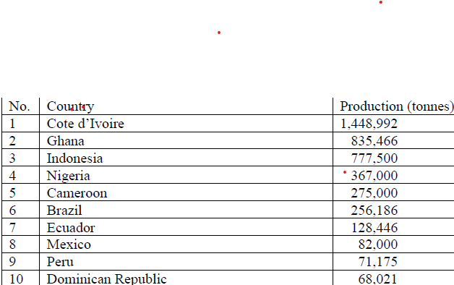
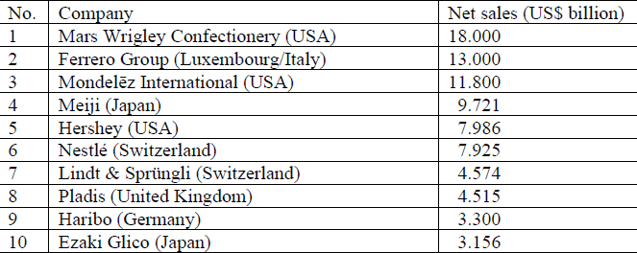
CHOCOLATE, A GLOBAL BUSINESS
Sorin-George Toma and Andreea Simona Săseanu
Chocolate has captured many consumer’s attention and led to the emergence of an industry that provides a food product with a unique flavour and taste. As a response, business organizations of all sizes and types, either small and medium enterprises or big corporations, has entered the chocolate industry. In order to meet consumer’s desire for new experiences chocolate makers and manufacturers are continuously innovating both in the production and marketing processes.
The paper aims to illustrate the main characteristics of chocolate and to present the key players acting in the global cocoa and chocolate markets, namely the largest cocoa producing countries and the largest chocolate companies.
Research results
In the period 2017-2018, the global cocoa market was dominated by Cote d’Ivoire, the largest cocoa producing country in the world (Table 1). In the period 2017-2019, the global chocolate market was dominated by Mars Wrigley Confectionery (USA), the largest chocolate company in the world. In 2019, five companies were from Europe (Ferrero Group, Nestlé, Lindt & Sprüngli, Haribo, Pladis- Table 2), three companies from North America (Mars Wrigley Confectionery, Mondelēz International, Hershey), and two from Asia (Meiji, Ezaki Glico). The results mentioned above show the dynamism of the two markets. In essence, several issues can be highlighted as follows:
-the booming global chocolate market has determined the rise of the global cocoa market as these two markets are connected;
-the global cocoa market is dominated by traditional producers from Africa, Asia, and Central and South America;
-the global chocolate market has been dominated by European and American companies.
Conclusions
The discover and exploitation of cocoa led to the emergence and development of chocolate industry. During the time, the chocolate manufacturing and marketing have transformed into a global multibillion dollars business.
The importance of the research is given by its theoretical contributions. First, the paper provides a better understanding of an old food product called chocolate. Second, it shows the expansion of chocolate business throughout the world and, therefore, its global dimension. Third, the paper demonstrates the need to analyse the global chocolate market in connection with the global cocoa market.
The purpose

