Slide 1
BASIQ 2020 | New Trends in Sustainable Business and Consumption
ASPECTS OF
WASTE MANAGEMENT
IN THE EUROPEAN UNION
Sorin Petrică Angheluță
Irina Elena Petrescu
Niculescu Marcela Antoneta
Elena Velicu Rusalca
4 – 6 June 2020, Messina, Italy

Slide 2
BASIQ 2020 | New Trends in Sustainable Business and Consumption
Abstract
People, through their economic activities, influence the environment. In urban areas, the population is growing. This phenomenon, in addition to the increases in the industry, leads to increased quantities of waste. In this way, besides socio-economic problems, environmental problems also appeared. Technologies that do not use raw materials in high percentages have negative effects on natural resources. Their exhaustion is also a consequence of the reduced use of raw materials. The article presents an analysis of the waste treated in the member countries of the European Union. A method of reducing the impact of waste on the environment is given by the application of technologies that reduce the quantities of waste generated. Some wastes are hazardous to human health. Their harmful effect is also affecting the environment. The composition of solid urban waste is influenced by the technologies used to produce the products, as well as the energy sources used. For this reason, it is beneficial for the environment to apply waste management systems in order to reuse and recycle them. Considering the predominantly urban distribution of the population of the European Union, the article presents the situation of municipal waste both generated and treated. An important contribution to sustainable development has a more efficient waste management. The circular economy can be considered as a solution to prevent the increase of the quantities of waste.
4 – 6 June 2020, Messina, Italy

Slide 3
BASIQ 2020 | New Trends in Sustainable Business and Consumption
Comparative situation of waste treated, European Union
Countries | 2004 | 2016
 | Total waste treatment (tonnes) | Total waste treatment (tonnes) | Share hazardous waste treatment (%) | Share non-hazardous waste treatment (%)
European Union | 2.114.190.000 | 2.311.650.000 | 3,32 | 96,68
Belgium | 32.985.766 | 43.506.358 | 5,63 | 94,37
Bulgaria | 195.064.838 | 116.858.250 | 11,28 | 88,72
Czechia | 22.521.031 | 22.913.480 | 2,31 | 97,69
Denmark | 12.892.738 | 19.062.523 | 9,89 | 90,11
Germany | 346.001.167 | 383.204.029 | 5,61 | 94,39
Estonia | 15.410.921 | 19.872.869 | 48,26 | 51,74
Ireland | 18.227.850 | 11.767.578 | 0,67 | 99,33
Greece | 25.499.043 | 70.074.704 | 0,60 | 99,40
Spain | 136.220.011 | 106.715.249 | 1,99 | 98,01
France | 283.391.472 | 304.814.284 | 2,35 | 97,65
Croatia | 4.756.565 | 3.684.489 | 2,06 | 97,94
Italy | 102.352.518 | 136.041.718 | 2,68 | 97,32
Cyprus | 1.182.660 | 1.953.732 | 7,24 | 92,76
Latvia | 988.139 | 1.836.259 | 1,12 | 98,88
Lithuania | 4.579.718 | 4.810.390 | 1,27 | 98,73
Luxembourg | 10.217.449 | 11.321.117 | 0,41 | 99,59
Hungary | 9.826.086 | 13.960.246 | 2,45 | 97,55
Malta | 3.097.939 | 1.472.647 | 0,03 | 99,97
Netherlands | 85.826.150 | 139.879.536 | 3,79 | 96,21
Austria | 51.627.556 | 60.028.645 | 0,75 | 99,25
Poland | 128.581.819 | 163.002.317 | 0,85 | 99,15
Portugal | 23.945.324 | 9.669.229 | 5,08 | 94,92
Romania | 210.514.539 | 175.698.723 | 0,20 | 99,80
Slovenia | 4.990.764 | 4.810.258 | 1,60 | 98,40
Slovakia | 12.104.130 | 7.923.648 | 2,16 | 97,84
Finland | 67.015.648 | 125.455.649 | 1,60 | 98,40
Sweden | 87.181.191 | 137.021.154 | 0,97 | 99,03
4 – 6 June 2020, Messina, Italy

Slide 4
BASIQ 2020 | New Trends in Sustainable Business and Consumption
Table 1 presents the comparative situation of the treated waste in the member countries of the European Union for 2004 and 2016.
At European level, the total waste treatment increased in 2016, compared to 2004, with +197.460.000 tonnes. The values increased in: Finland (+58.440.001 tonnes), Netherlands (+54.053.386 tonnes), Sweden (+49.839.963 tonnes), Greece (+44.575.661 tonnes), Germany (+37.202.862 tonnes).
The decrease in the amount of total waste treatment was registered in: Bulgaria (-78.206.588 tonnes), Romania (-34.815.816 tonnes), Spain (-29.504.762 tonnes), Portugal (-14.276.095 tonnes).
In 2018, the countries where the total waste treatment quantities were high are: Germany (383.204.029 tonnes), France (304.814.284 tonnes), Romania (175.698.723 tonnes), Poland (163.002.317 tonnes).
In 2016, the countries with the highest share of hazardous waste treatment were: Estonia (48,26%), Bulgaria (11,28%), Denmark (9,89%), Cyprus (7,24%), Belgium (5,63%). The share of non-hazardous waste treatment had high values for: Malta (99,97%), Romania (99,80%), Luxembourg (99,59%), Greece (99,40%), Ireland (99,33%).
4 – 6 June 2020, Messina, Italy

Slide 5
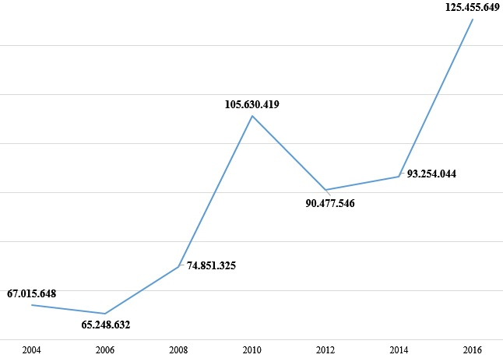
BASIQ 2020 | New Trends in Sustainable Business and Consumption
Evolution of the total quantity of waste treatment, 2004-2016, Finland
In Finland, compared to 2004, the amount of total waste treatment increased significantly (+58.440.001 tonnes).
It is observed that the periods of decrease of values were: 2004-2006, 2010-2012. For the other periods the trend was increasing (2006-2010, 2012-2016).
4 – 6 June 2020, Messina, Italy

Slide 6
BASIQ 2020 | New Trends in Sustainable Business and Consumption
Comparative situation of municipal waste generated and treatment
Countries | Municipal waste generated |  | Municipal waste treatment
 | 2009 | 2018 | 2009 | 2018
European Union | 257,042 | 250,474 | 249,482 | 246,668
Belgium | 5,042 | 4,698 | 4,779 | 4,698
Bulgaria | 4,449 | 2,973 | 4,309 | 2,922
Czechia | 3,310 | 3,732 | 2,894 | 3,732
Denmark | 4,206 | 4,436 | 4,206 | 4,436
Germany | 48,466 | 51,013 | 48,466 | 51,013
Estonia | 452 | 535 | 383 | 505
Ireland | 2,953 | 2,768 (2017) | 2,825 | 2,724 (2017)
Greece | 5,154 | 5,415 (2017) | 5,154 | 5,415 (2017)
Spain | 25,108 | 22,222 | 25,108 | 22,222
France | 34,426 | 35,272 | 34,426 | 35,272
Croatia | 1,743 | 1,768 | 1,732 | 1,619
Italy | 32,107 | 30,165 | 29,840 | 27,488
Cyprus | 589 | 547 (2017) | 589 | 505 (2017)
Latvia | 753 | 785 | 753 | 676
Lithuania | 1,206 | 1,301 | 1,196 | 1,167
Luxembourg | 338 | 371 | 338 | 371
Hungary | 4,312 | 3,729 | 4,284 | 3,746
Malta | 268 | 310 | 268 | 285
Netherlands | 9,738 | 8,806 | 9,738 | 8,806
Austria | 4,921 | 5,119 | 4,788 | 5,041
Poland | 12,053 | 12,485 | 10,054 | 12,485
Portugal | 5,496 | 5,222 | 5,496 | 4,986
Romania | 7,768 | 5,296 | 6,246 | 5,134
Slovenia | 1,069 | 1,009 | 851 | 795
Slovakia | 1,654 | 2,254 | 1,583 | 2,253
Finland | 2,562 | 3,041 | 2,562 | 3,041
Sweden | 4,390 | 4,416 | 4,390 | 4,416
4 – 6 June 2020, Messina, Italy

Slide 7
BASIQ 2020 | New Trends in Sustainable Business and Consumption
Table 2 presents the comparative situation of municipal waste generated and treatment in the member countries of the European Union (thousand tonnes).
Regarding municipal waste generated, it is noted that, in 2018, the highest quantities were generated by Germany (51,013 thousand tonnes), France (35,272 thousand tonnes), Italy (30,165 thousand tonnes), Spain (22,222 thousand tonnes). Also, the lowest quantities generated were recorded in: Malta (310 thousand tonnes), Luxembourg (371 thousand tonnes), Estonia (535 thousand tonnes), Latvia (785 thousand tonnes), Slovenia (1,009 thousand tonnes).
In 2018, the countries where the amount of municipal waste treatment was high are: Germany (51,013 thousand tonnes), France (35,272 thousand tonnes), Italy (27,488 thousand tonnes), Spain (22,222 thousand tonnes).
For 2018, there is a negative difference between municipal waste generated and municipal waste treatment in: Italy (-2,677 thousand tonnes), Portugal (-236 thousand tonnes), Slovenia (-214 thousand tonnes), Romania (-162 thousand tonnes), Croatia (-149 thousand tonnes), Lithuania (-134 thousand tonnes), Latvia (-109 thousand tonnes).
4 – 6 June 2020, Messina, Italy

Slide 8
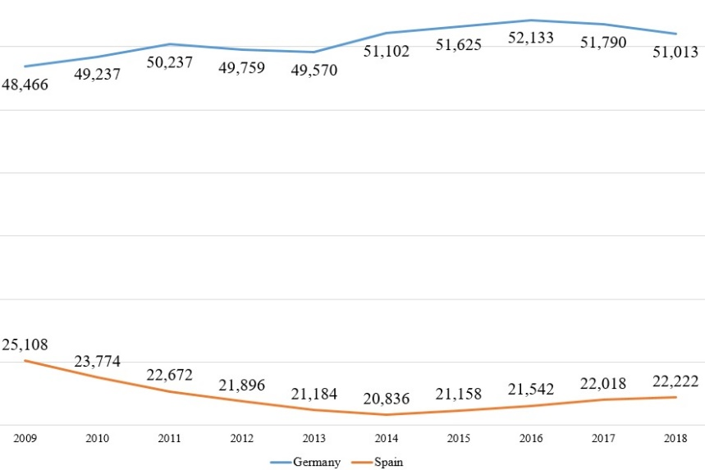
BASIQ 2020 | New Trends in Sustainable Business and Consumption
Evolution of the quantities of municipal waste generated,
Germany and Spain, 2009-2018 (thousand tonnes)
The quantity of municipal waste generated for Germany had a relatively increasing trend for the period 2009-2016, and for the period 2016-2018 the trend was decreasing. In 2018, compared to 2009, had an increase of + 2,547 thousand tonnes.
For Spain, the quantity of municipal waste generated decreased in 2009-2014, and in 2014-2018 the trend was increasing. In 2018, there were significant decreases compared to 2009: -2,886 thousand tonnes.
4 – 6 June 2020, Messina, Italy

Slide 9
BASIQ 2020 | New Trends in Sustainable Business and Consumption
Comparative situation of municipal waste generated and treatment,
2009-2018 (kilograms per capita)
Countries | Municipal waste generated |  | Municipal waste treatment
 | 2009 | 2018 | 2009 | 2018
European Union | 511 | 488 | 496 | 481
Belgium | 467 | 411 | 443 | 411
Bulgaria | 598 | 423 | 579 | 416
Czechia | 317 | 351 | 277 | 351
Denmark | 762 | 766 | 762 | 766
Germany | 592 | 615 | 592 | 615
Estonia | 339 | 405 | 287 | 382
Ireland | 651 | 576 (2017) | 623 | 567 (2017)
Greece | 464 | 504 (2017) | 464 | 504 (2017)
Spain | 542 | 475 | 542 | 475
France | 534 | 527 | 534 | 527
Croatia | 405 | 432 | 402 | 396
Italy | 543 | 499 | 505 | 455
Cyprus | 729 | 637 (2017) | 729 | 587 (2017)
Latvia | 352 | 407 | 352 | 351
Lithuania | 381 | 464 | 378 | 417
Luxembourg | 679 | 610 | 679 | 610
Hungary | 430 | 381 | 427 | 383
Malta | 649 | 640 | 649 | 587
Netherlands | 589 | 511 | 589 | 511
Austria | 590 | 579 | 574 | 570
Poland | 316 | 329 | 264 | 329
Portugal | 520 | 508 | 520 | 485
Romania | 381 | 272 | 307 | 264
Slovenia | 524 | 486 | 417 | 383
Slovakia | 307 | 414 | 294 | 414
Finland | 480 | 551 | 480 | 551
Sweden | 472 | 434 | 472 | 434
4 – 6 June 2020, Messina, Italy

Slide 10
BASIQ 2020 | New Trends in Sustainable Business and Consumption
Table 3 presents the comparative situation of municipal waste generated and treatment, in the member countries of the European Union (kilograms per capita).
in 2018, municipal waste generated in kilograms per capita had the highest values in Denmark (766 kilograms per capita), Malta (640 kilograms per capita), Germany (615 kilograms per capita), Luxembourg (610 kilograms per capita), Austria (579 kilograms per capita). The countries with the lowest municipal waste generated in kilograms per capita were: Romania (272 kilograms per capita), Poland (329 kilograms per capita), Czechia (351 kilograms per capita), Hungary (381 kilograms per capita), Estonia (405 kilograms per capita).
In terms of waste treatment in kilograms per capita, in 2018, the countries with the highest values were: Denmark (766 kilograms per capita), Germany (615 kilograms per capita), Luxembourg (610 kilograms per capita), Malta (587 kilograms per capita), Austria (570 kilograms per capita). Low values were recorded in: Romania (264 kilograms per capita), Poland (329 kilograms per capita), Czechia (351 kilograms per capita), Latvia (351 kilograms per capita), Estonia (405 kilograms per capita).
4 – 6 June 2020, Messina, Italy

Slide 11
BASIQ 2020 | New Trends in Sustainable Business and Consumption
Conclusions
From the analysis presented, it was found that in the member countries of the European Union the total waste treatment increased from 2.114.190.000 tonnes (in 2004) to 2.311.650.000 tonnes (in 2016).
Regarding municipal waste generated, it is noted that, in 2018, the highest quantities were generated by the countries with the largest population (Germany, France, Italy, Spain). The highest quantities of municipal waste treatment were recorded in these countries.
Municipal waste generated in kilograms per capita were higher in: Denmark, Malta, Germany, Luxembourg, Austria. Also in these countries were the highest values for municipal waste treatment in kilograms per capita.
The technologies by which the products are manufactured influence globally global warming and environmental pollution. Municipal waste consists mostly of waste generated by households, but also includes waste generated by small institutions and businesses.
Climate change and human activities can destabilize the critical processes of the planetary system. The increase of industrial activities, due to the increasing demands, leads to an increased consumption of resources. Thus, waste can be included in reuse programs to create additional value.
4 – 6 June 2020, Messina, Italy

