Slide 1
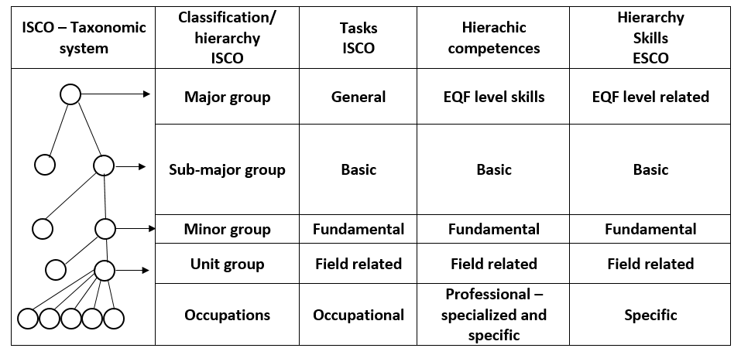
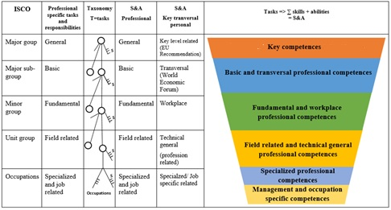
SKILLS AND COMPETENCES PYRAMID V. STUDY PROGRAMS
Cristina Vasilica Icociu, Nicolae Postăvaru, Mihnea Costoiu, Tiberiu G. Dobrescu and Cătălin Ionuț Silvestru
We are introducing a pyramid of skills starting from ISCO, a hierarchy and a new classification depending on how they are acquired: i) naturally, through DNA and social environment and ii) through education and learning. The main idea is that without a seed there are no flowers. Hence, another form of organization of skills and competences, a new scheme presented for the first time here. Finally, we come to a new systematization of skills known in literature and the creation of common disciplines for several study programs, without discussing professional disciplines. This step can lead to the partial recognition of a qualification, about 30-40%, especially since, in our opinion, these common disciplines should be compulsory at bachelor level.

